Slide 1
Welcome to
Template Transactions
Part 1
Notes:
Welcome to the Summer Salary training course.
This UCPath training course is designed to teach you about Summer Salary guidelines, as well as how summer salary is recorded in UCPath.

Slide 2


Introductions
Instructor
Name: Angel Rivera
UCI Role: Training Lead
2 Years in UCPath
10 Years of PeopleSoft related experience.

Slide 3
General Rules
Classroom Etiquette:
Please silence cell phones
Keep your mics muted
No email or web surfing
Return from breaks on time
Please communicate via zoom chat

Slide 4
Template Transactions Pt.1
Template Transactions Pt. 1
1. Template Transactions Overview
4. Approvals and Transaction Status
2. Full Hire
3. Concurrent Hire

Slide 5

Course Objectives
By the end of this course, you should be able to:
  Identify the actions that are processed using SmartHR Templates.
  Identify the pages used to initiate template transactions.
  View template transaction status after submission.
  Describe the key system steps to complete a hire, termination, and other template transactions.
  Enter SmartHR Template transactions.
  Describe the AWE process.

Slide 6
Key Concepts & Vocabulary
UCPath Term | Definition
Location | A Location is a University of California (UC) campus and its associated medical center, if applicable. For example, UCI is a Location and includes both the campus and the UCI Medical Center
Business Unit | Each UC campus and medical center is identified by a ‘Business Unit’ which will be used to segregate campus information for reporting and system security access. For example: IRCMP = UCI Campus IRMED = UCI Medical Center.
Approval Workflow Engine (AWE) | Approval Workflow Engine (AWE) systematically routes transactions in UCPath to designated roles (e.g., WFA Approver) for approval at the location. Once these approvals are complete, transactions are either routed to the UCPath Center (UCPC) for finalization or are finalized in UCPath.
Contingent Worker (CWR) | Individuals who have a relationship with the University but do not receive pay from the University.

Slide 7
Key Concepts & Vocabulary (cont’d)
UCPath Term | Definitions
Row Level Security | Row Level Security controls the employee population a user has access to, and who they can see or submit a transaction for.
Role Level Security | Role Level Security controls what pages a user can see and what actions they can take on each page.
Job Earnings Distribution | Job Earnings Distributions are used to distribute earnings by Earnings Code (which are like PPS DOS codes) on the Job Record either by percent. (e.g., ERIT, HSCP).
UCPC WFA Team | Team at the UCPath Center that processes template transaction data in the UCPath system. (WFA = Work Force Administration.)
FTE | Full time equivalent or employment percentage of full time. No longer tied to permanent budget.
Position Number | A unique number that relates to a set of attributes and represents a slot in UCI’s organizational structure. A position can be filled or vacant. All employees at UCI will inhabit a position.

Slide 8
PART 1: Lesson 1
Template Transactions Overview

Slide 9

Lesson Objectives
Template Transactions Overview
Approvals and Status
Full Hire
In this lesson you will :
Identify the actions that are processed using templates.
Review the template transaction system process.
View employee information using the Person Org Summary page & Workforce Job Summary page.
Identify the elements of the Smart HR Transactions page.

Slide 10
Actions with SmartHR Templates
The actions that are processed using templates include:
New Hires
Contingent Workers
(CWR)
Concurrent Hires
Rehires
Personal Data Changes
Retirement
Intralocation Transfers
Interlocation Transfers
Terminations
Template Transactions are initiated by the location/department. An Approval Workflow Engine (AWE) will route transactions to be approved by the location and/or the UCPath Center.
Notes:
Primary focus of Part 1 will be on the highlighted areas – New Hire, Contingent Workers, & Concurrent Hires

Slide 11
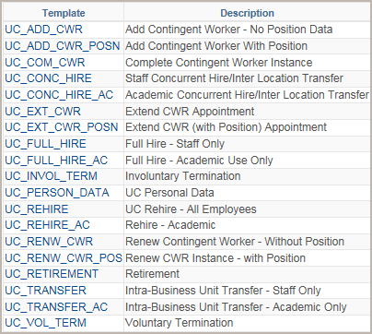
Available SmartHR Templates
Template transactions are initiated through a UCPath template-based page called Smart HR Templates.
Available Templates
Custom templates provide the fields necessary to complete the transaction all in one place.
In many cases, there is a template specific to academic and another specific to staff.
For example:
  Full Hire - Staff Only
  Full Hire - Academic Use Only
v
Notes:
Smart HR Templates are custom templates that provide the fields necessary to complete the transaction all in one place.
There are several templates that are specific to academic and another version specific to staff. When these templates are selected, the fields and values relevant for academic or staff hires are available.

Slide 12
System Security by Template
Some templates have system security features enabled that prevent initiators from entering transactions for users in different Business Units and/or departments.
Below is an example of what type of security is enabled for certain templates.
Location Specific | UCI Department | Any Location/Department
Rehire | Involuntary Termination | Concurrent Hire
Renew Contingent Worker | Voluntary Termination | Full Hire
Intralocation Transfer | Personal Data | Add Contingent Worker with Position
Rehire Reinstatement | Retirement | Add Contingent Worker (No Position)
 | End CWR Assignment
 | Extend CWR Assignment
Notes:
Template Transactions are initiated by the location/department.
Business Unit equates to a UC location and its medical centers – like UCLA, UCI, UCB, etc., so the use of the templates in this column will can be initiated for employees across the entire campus.
Department level security templates will show employees in the Initiator’s assigned department(s).
Templates listed in the No Security column can be initiated for employees across the entire UC system.
Once these templates are submitted, Approval Workflow Engine (AWE) will route transactions to be approved by the location and the UCPath Center.

Slide 13




Template Transactions – System Process
Review Person Org Summary page
Enter and Submit Template Transaction
Review/ Approve Template Transaction
Process Template Transaction
View Employee Data
Review the process:
UCI
Dept. Initiator
UCI
Dept. Initiator
UCI
Dept. Approver
UCPC
WFA Team
All
AWE
AWE
Notes:
Review Template Transaction process.
The Initiator role has access to the Template functionality in UCPath. The Initiator reviews the Person Org Summary page (like IDOC) before initiating a template transaction. This page provides the status of the employee’s current assignments. If you are initiating a full hire template, you should use this page to validate that the person does not already exist in UCPath. You can also use the Workforce Job Summary page. If you don’t know the employee’s ID you can use the Search Match page to find the ID.
Before a hire template can be initiated, the position must already exist in UCPath. If it does not, a Position Initiator must initiate a request to have the position entered (and funding if available) prior to hiring the employee.
A Location Template Initiator enters the template. When the template is saved and submitted, the transaction automatically routes for approval using Approval Workflow Engine (AWE).
Next, a designated Location Template Approver reviews and, if applicable, approves the template transaction. After it is approved, the template is staged for processing. There may be multiple approvers depending on your Location’s business process.
WFA Production at UCPath Center (UCPC) processes the template and saves the employee’s information to the UCPath tables. (This step is not part of the AWE process.)
In some cases, UCPC WFA Production may need to cancel a transaction. Comments explaining the cancelled transaction are added in UCPath. In some cases, Initiators can clone the cancelled template, enter corrections and submit the updated transaction.
After the templates are processed by WFA Production, users that have row-level security access to the employee data are able to view it.

Slide 14
Focus of Template Transactions
The Template Transactions courses focus on the Initiator tasks.
Location
Template Initiator
Location
Template Initiator
Location
Template Approver
WFA Production
All
Review Person Org Summary Page
Enter and Submit Template Transaction
Review/
Approve Template Transaction
Process Template Transaction
View Employee Data
AWE
Notes:
For the purposes of this course, template transactions part 1 will focus on the highlighted portions of the system process.

Slide 15

Position Control– Refresher
There are 3 primary data components in UCPath Position, Person and Job.
When an employee is hired into a position, a job is created.
Position
Person
Job
Administrative Assistant
Employee - John Jones
John Jones - Administrative Assistant
Notes:
This slide serves as a quick refresher from the Positon Control course. Once a person is hired into an already created position a job is created.
Click for animation
We are now going to focus on this part of the equation, hiring a person to create the job.

Slide 16

Navigating to Workforce Job Summary
Notes:
Check the Person Organizational Summary before entering Smart HR Template. Does a person exist in the system? Yes or no depends on what you do next.

Slide 17

Workforce Job Summary
Use this page to view employee job history.
Each row of information relates to an entry/change to the employee’s job record.
  For example: hire date, pay rate changes, and other data changes.
Notes:
The workforce job summary page is security enabled, unlike the person org summary page. This page will only provide access to the employees you have been granted access to in KSAMS (row level security)

Slide 18
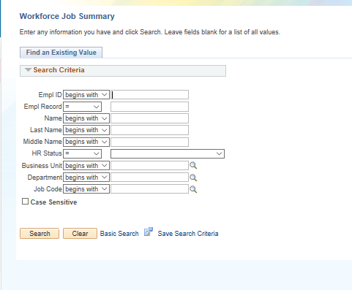
Searching in Workforce Job Summary
The Workforce Job Summary page is security enabled and will only allow you to search and review employees you have Row level access to.
Use any of the available search fields to find specific employees, or a group of employees in a specific department or organization.

Slide 19
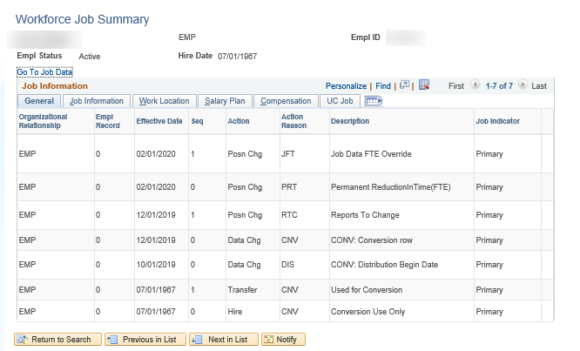
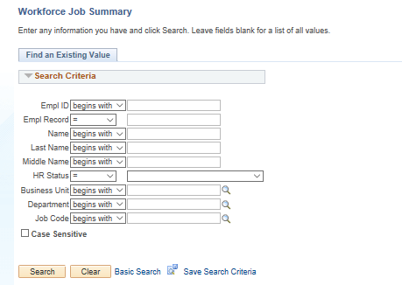
Workforce Job Summary (cont’d)
Navigation: PeopleSoft Menu > Workforce Administration > Job Information > Review Job Information > Workforce Job Summary
The header, above Job Information section, displays the employee’s statuses, indicates which job is the Primary Job, Hire Date, and, if applicable, the Termination Date of the assignment.
Notes:
The workforce job summary page provides additional current and historical job details pertaining to that employee. You have the ability to see General information, job details (job code, FTE), work location (dept., BU details), Salary plan and step information, Compensation details (pay group, pay frequency), and UC job data which displays (probation dates, ERIT, post doc anniversary dates.) – This is a holistic view of employee / job details which includes history along with a data trail of changes that were made.

Slide 20
Workforce Job Sum VS. Person Org Sum
Workforce Job Summary
Person Org. Summary
Displays complete Employee Job History (No earlier than 12/1).
Record of changes to various data.
Security enabled search page– can only view employees you have been assigned access to.
Displays current & historical compensation history.
Job data details are spread across different tabs.
Includes current basic job data information.
Does not display historical job data.
Page is not security enabled - can view any employee across any UC Location.
Does not display compensation details.
Allows user to view all employee job records.
VS.

Slide 21

Using Smart HR Templates

Slide 22

Template Transaction User Guide
Template Transactions User Guide is available here.
Assists in choosing the correct template and the corresponding reason code.
Open the UCPath Help site and refer to the Template Transactions – Action Reason Codes and Descriptions topic.
Ask your instructor for assistance.
Notes:
For UPK job aids, instruct the users to open the job aid and review the online PDF version.
This job aid is referenced throughout Template Transaction training courses, as the various types of template transactions are practiced.

Slide 23
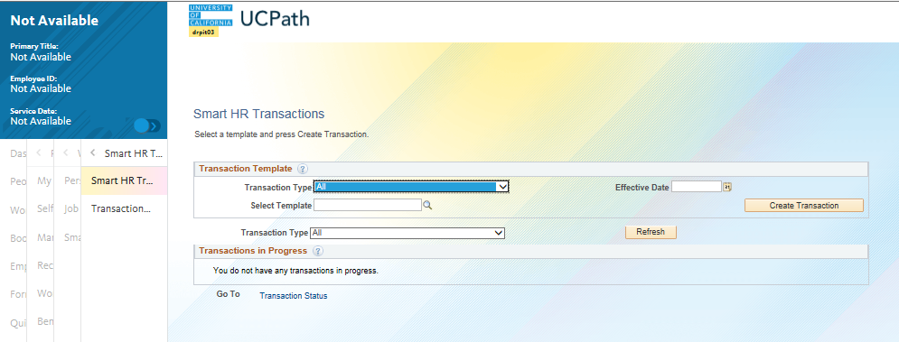
Smart HR Transactions – Navigation
Navigation: PeopleSoft Menu > Workforce Administration > Smart HR Template > Smart HR Transactions
The Smart HR Transactions page is the starting point to initiate a template transaction.
FYI: You can click the slide button to expand menu
Notes:
This is where you’ll go to start initiating your hire transaction after you’ve checked the Person Org Summary page and applicable reports.

Slide 24
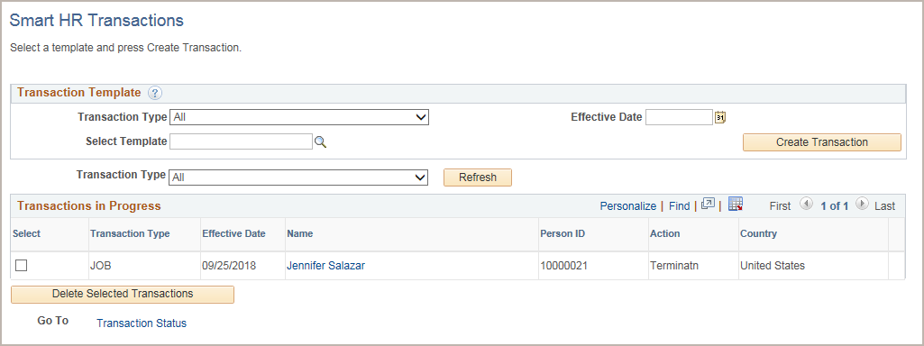
Smart HR Transactions – Page
Use the Transaction Template section to select the type of template appropriate for the request, enter the Effective Date and Create Transaction.
Use the Transactions in Progress section to review the template transactions you have submitted or saved for later. You also can select and delete your transactions.
Use the Select Template field to select the appropriate template.
Enter the Effective Date for the selected template.
Click Create Transaction to enter the template details.
If needed, you can delete transactions you have saved for later or submitted. Use caution because this deletes the transaction from the system. If the transaction was submitted it also removes it from AWE Approver worklists.
Notes:
Click for Animation
When displayed in Slide Show mode, this slide includes animation for the gray captions. Click to individually display each caption (and hide the previous caption) as you describe the objects on the Smart HR Transactions page.
The Transactions in Progress section displays only the transactions you have submitted or have “saved for later.” You can drill down into the transaction to view the approval chain. After the transaction is approved in AWE, it no longer appears on this list. At that point you can use the Transaction Status page to view the transaction’s progress within WFA Production processing.

Slide 25
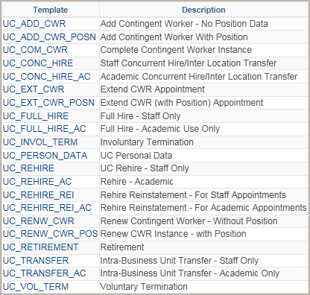
Smart HR Transactions – Template Selection
The templates are configured to support the update of the appropriate UCPath component or page, such as Job Data, Personal Data, Person Profile and Additional Pay.
Use the Select Template look up to select the template for the transaction you need to initiate.
Click the Search button to select a template.
Notes:
Click for Animation
The Transaction Type fields provides filtering options when there is a long list of templates. The template list at UC is short; therefore, it is not beneficial to filter or to use the Transaction Type field.
Samples of each of these Templates are covered in the Template Transactions – Part I and Template Transactions – Part II training courses.

Slide 26

Contingent Workers (CWR)
Contingent Workers
  Have a relationship with the University.
  Do not receive pay from the University.
  Only Contingent Workers who supervise others are required to have a position. Otherwise they do not have positions.
  Two separate templates for adding CWRs: with and without positions.
UC Net ID will automatically be created for the CWR once the SMART HR template has been processed into UCPath. Sponsored Net ID is NO LONGER required.
UCI Employee Roster report will include CWR job end dates to help the supervisors keep their data current.
Some CWRs may be required to sign Patent Acknowledgment as a condition of access to University research facilities or contracts, grants, or other funds through the University.
CWRs will have access to the Self Service Portal.
Notes:
Click for animation for bottom text box
There is a contingent worker user guide that will be published to the ucpath.uci.edu website which provide in depth information and guidance on CWR.
UPK simulations are available to review how to add a CWR.

Slide 27

Contingent Workers – Examples
Staff/Student Volunteer
Staff Intern
Individual Contractor / Consultant (paid through Accounts Payable)
Visiting Student (Graduate and Undergraduate)
Visiting Scholar
Clinical Associate / Admitting Physician
Research Fellow / Associate
Development Supporter
Consult your Academic Personnel or Human Resources Coordinator for guidance on entering Contingent Workers.
Notes:
At conversion, the title codes mentioned here will all have job codes in UCPath that begin with CWR#### (i.e., Staff Volunteer Job Code = CWR011)
For more examples and definitions please see UCI BPG WFA.01 Add or Renew Contingent Worker

Slide 28
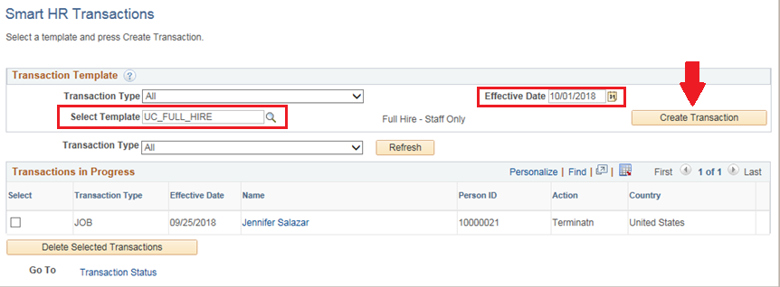
Smart HR Transactions – Create Transaction
After you select the template, enter the Effective Date for the HR action. In this example, it is the hire date.
Click the Create Transaction button to initiate the template.
Notes:
Effective Date field is required for all template transactions. This date represents the date the status becomes current or active.
For termination & retirement actions, effective date should always be greater than the Last Date worked (field available on termination / retirement templates). In general, effective date for termination and retirement actions is equal to the day after the last day on active status. First day on the beach.

Slide 29
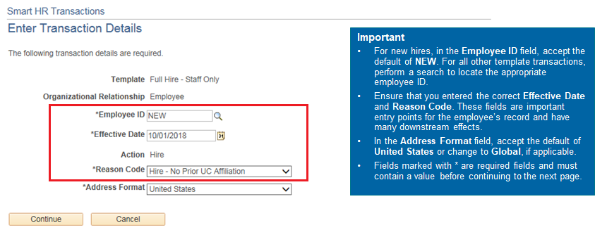
Smart HR Transactions – Details
Use the Enter Transaction Details page to enter the Employee ID, if needed, and Reason Code.
Each template has a unique list of Reason Codes.
Notes:
As the note in blue box states, the Effective Date and Reason Code fields need to be considered carefully as they have many downstream impacts. If the Effective Date needs to be updated from what was entered on the previous page, it can be changed now.
The template transaction pages are reviewed in more detail as specific templates are covered in each Lesson later in the course.

Slide 30

Lesson Complete
Having completed this Lesson, you should be able to:
Identify the actions that are processed using templates.
Review the template transaction system process.
View current employee information using the Person Org Summary page.
Identify the elements of the Smart HR Transactions page.
Review the templates, Action Reason codes and descriptions.
View template transaction status.

Slide 31

Lesson 1: Key Points
The Smart HR Transactions page is the starting point to initiate any type of template transaction.
Refer to the Template Transactions – Action Reason Codes and Descriptions UPK job aid for a list of all the templates, the associated Reason Codes and description.
Comments are needed on the template to further explain the template transaction. This is important!
Supporting documentation should be attached as needed.
Approval is required for template transactions.
Benefits Eligibility is determined by job data attributes.
Notes:
. The Job Aid gives the Reason Codes available for each Action.

Slide 32

Lesson Review
Knowledge Check:
You now have the opportunity to assess your knowledge of the information presented in this Lesson.
The questions and answers presented in this review help you to determine whether you remember and understand the important points.

Slide 33
Multiple Choice
Use the Person Org Summary page to view current information for organizational relationships, including:
A. Academic Employees
B. Temporary Employees
C. All Employee and Contingent Workers
D. Terminated Employees
Notes:
Click for animation

Slide 34
True or False
UCI and locations use the Smart HR Transactions page to hire employees.
True
False
Notes:
Click for animation
Correct answer: True

Slide 35
Multiple Choice
Use the _____________ page to view the status of a template transaction that is in the approval workflow (AWE).
A. Workflow Status
B. Smart HR Transactions
C. Transaction Status Page
D. None of the above
Notes:
Click for animation
Correct answer: B

Slide 36
PART 1: Lesson 2
Full Hire Template
(UC_FULL_HIRE)
(UC_FULL_HIRE_AC)

Slide 37
Lesson Objectives
Template Transactions Overview
Approvals and Status
Full Hire
Concurrent Hire
In this lesson you will:
Describe the key system steps to complete a full hire template transaction.
Understand how to use the Search/Match page.
Initiate a full hire template transaction.
Review how I-9 verification information is added to the Person Profile of employee job record.

Slide 38

Person Org Summary & Person Search Match

Slide 39
Person Org. Summary Overview
The Person Organization Summary page displays basic current employee information on all organizational relationships for Employees and Contingent Workers (CWR).
An employee may have more than one organizational relationship concurrently. For example, the person may be an employee at one UC Location and a CWR at another. Please look to see if additional rows of data exist.
Person Org Summary page does not have any security restrictions.
All employees with initiator, approver, or inquiry , at every location, will have access to this page to view employee information across all locations.
This page does not display historical or future-dated employment details.
Notes:
There are reports to view historical and future-dated information for employees. It is highly recommended that you review those reports also before processing a template transaction to get a true picture of what is going on with the employee.

Slide 40
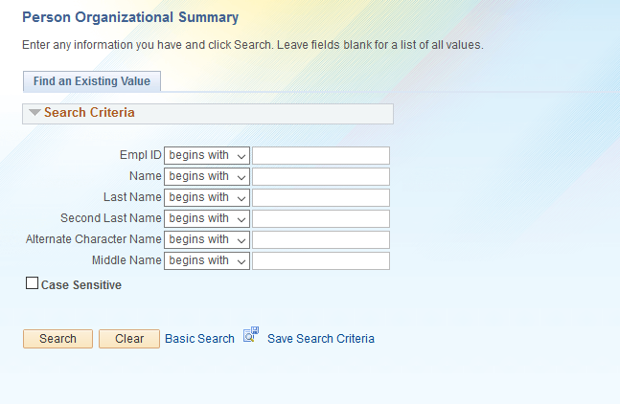
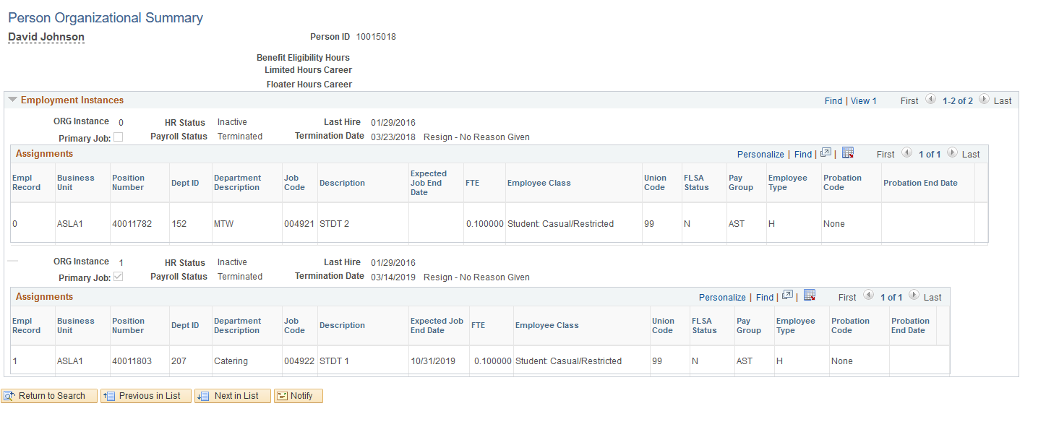
Person Organizational Summary
Navigation: PeopleSoft Menu > Workforce Administration > Personal Information > Person Organizational Summary
If there is more than one row of data, click the View All link to view all current information.
The header, above each Assignments section, displays the employee’s statuses, indicates which job is the Primary Job, Hire Date, and, if applicable, the Termination Date of the assignment.
Notes:
PLEASE CLICK FOR ANIMATION
This is a slide to show Person Org Summary. This page is used to view the summary of an employee’s current organizational relationships across all of the University of California locations.
The Person Organizational Summary page displays information for Employees and CWRs. The purpose of this step is to make sure that whatever action you want to initiate is not going to conflict with the terms and conditions of current employment. Initiators should look here to make sure there is no conflict with existing personnel or controlling policies and resolve any conflicts before moving forward to the next step and initiating the transaction.

Slide 41
Search/Match Overview
Before entering a new hire, you must check Person Org Summary or conduct a person Search/Match.
  Verify the employee does not already exist in UCPath.
Both Pages allow searching using various criteria.
When performing a Search/Match, use the following search fields:
  The employee’s Social Security number, if you have it.
  The employee’s first name and/or last name.
  The employee’s Date of Birth.
Use multiple search criteria to limit the search results.

Slide 42
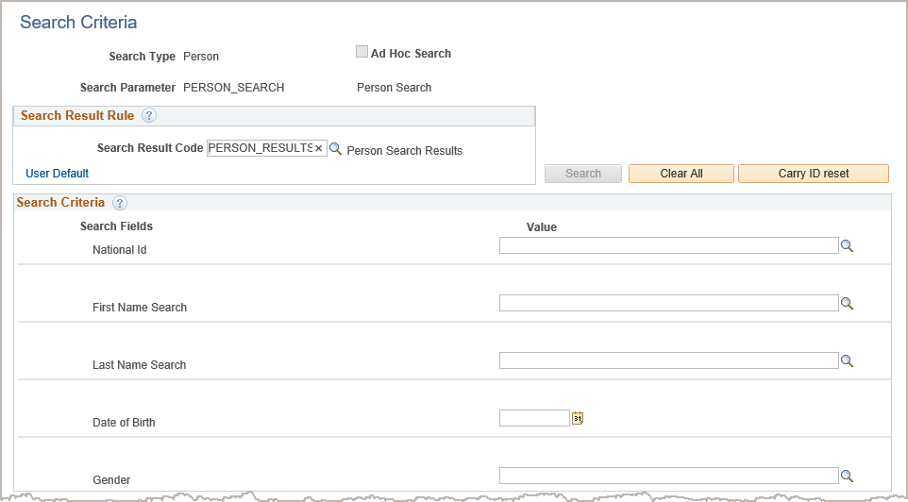
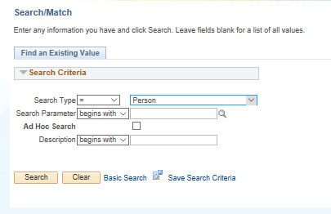
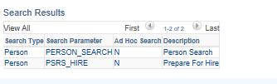
Search/Match Page
Navigation: PeopleSoft Menu > Workforce Administration > Personal Information > Search for People
Use the Search Criteria section to enter the known person data.
The Search button becomes active after you enter search criteria.
Notes:
In order to avoid entering duplicate employees in UCPath, check the Search Match page. Use the following criteria to conduct your search.
The employee’s Social Security number, if you have it.
The employee’s first name and/or last name and the date of birth.
The employees first and last name.
If the person already exists in UCPath it would determine which template and Action/Reason Codes that are used. It’s possible they could be entered using the Rehire template or the Full Hire template with a Rehire Reason Code.

Slide 43
Full Hire – Key System Steps
Review Person Org Summary page and conduct search using Search/Match
Navigate to the Smart HR Transactions page
Select the UC_FULL_HIRE template for Staff or UC_FULL_HIRE_AC for Academic
Enter hire details and attach supporting documentation as needed
Save and Submit
Notes:
Full Hire Template Transaction key system steps.
Access the Person Org Summary page before initiating a hire template transaction to validate that the person does not already exist in UCPath. You should also use the Search/Match page.
Navigate to the Smart HR Transactions page.
Select the appropriate hire template: Academic or Staff.
Enter the employee’s personal information, job information, JED and additional pay as needed.
Comments for the approvers should be entered in Initiator Comments field. Any information that is meant for UCPC WFA Production, and cannot be entered in one of the existing fields, are entered in Comments field.
When the transaction is complete, select the Save and Submit button.
After the Initiator saves the transaction, it is automatically routed for approval using AWE. A designated Location Template Approver reviews and, if applicable, approves the transaction. After AWE, the template is staged until it is processed by UCPC WFA Production.

Slide 44
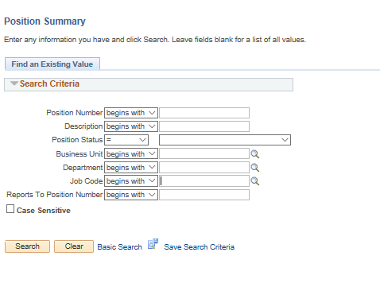
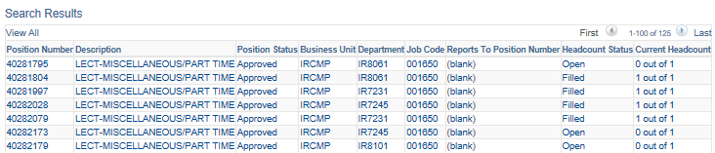
Finding a Vacant Position
Please determine if there is an existing vacant position with desired title code in your department before creating a new one. HR initiators can use the Position Summary page to view open and filled positions for any departments they have security access to.
Navigation: PeopleSoft Menu > Organizational Development > Position Management > Position Summary
Notes:
Animation on Slide!
Please refer to position control course for guidance on updating or creating new positions.
Image 1: When searching for vacant positions, using a combination of the following fields would be most effective.
Image 2: Once you entered your search parameters, the search results will display matching position information. Initiators can view which positions are vacant vs. filled per their respective department access, along with position numbers in the event an update needs to be applied after review.

Slide 45

Changes to Position and Job FTE
FTE (Full-Time Equivalent) does not indicate a permanently budgeted position. In UCPath, it will only reflect the employees percentage of time worked.
UCPath: FTE can be either changed at position or at a job level.
Changing Position FTE | Changing Job FTE
Vacant positon – changes to FTE for vacant positions can be done via the Position Control Form (PeopleSoft Menu > UC Customizations > UC Extensions > Position Control Request). Filled position – changes to FTE for filled positions can be done via PayPath. See UPK “Initiate Position Data Change PayPath Transaction (Acad FTE Change) or (Staff FTE Change) for step by step instructions. | You can also keep the position FTE as 1.00 and only change the job FTE. This will require you to first decouple the position and job FTE so they are independent. Once decoupled the job FTE can be adjusted as needed. See UPK “Initiate Job Data FTE Override PayPath Transaction (Staff/Acad)” for step by step instructions.
Notes:
Click for animation - bottom table
Reminder: FTE is established on the position.

Slide 46
Full Hire – Overview
The full hire template transactions create a new job/employment record for a person who receives compensation through UCPath Payroll processing.
Available Templates
Separate hire templates are available for academic and for staff full hires.
Use the Full Hire Template - to hire a NEW employee or rehire an employee that previously worked in a Non-UCPath business unit or location.
.
Notes:
Remember, the Rehire template has BU security on the Empl ID and Empl Record fields. The Full Hire template does not have any security on the Empl ID field.
Business Unit is as defined before. For example, UCI Campus is a business unit. UCI Medical Center is a business unit.

Slide 47
Smart HR Transactions – Page
Navigation: PeopleSoft Menu > Workforce Administration > Smart HR Template > Smart HR Transactions
Use the Select Template field to select the appropriate template.
Enter the Effective Date
(date the transaction becomes active).
Notes:
Click for animation
As a reminder, before initiating any template transaction, please check the person organizational summary page to verify employee’s details and status. Also conduct a person search match if hiring a new employee.
Let’s continue with step two of the Full Hire process.
Navigate to the Smart HR transactions page to select full hire template. Enter the Effective Date and click the Create Transaction button.

Slide 48
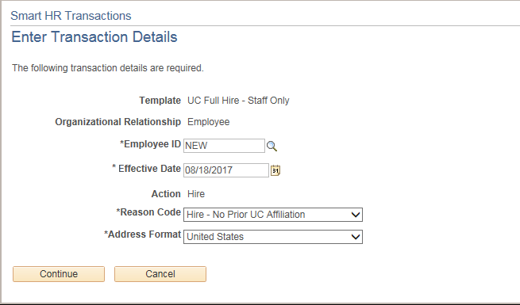
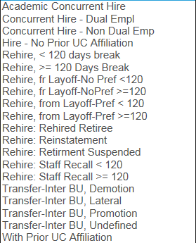
Enter Transaction Details Page
Enter the details for the full hire, review Effective Date (hire date) and select the Reason Code.
Important
Ensure that you select the correct Job Effective Date (hire date) and Reason Code.
These fields are important entry points for the employee’s record and have many downstream effects.
For new hires, accept the default of NEW. The system to automatically assign the employee ID when the transaction is processed by WFA Production.
Select the Reason Code.
Reason Codes
Click Continue to enter the remaining details of the template.
Notes:
Click for animation
Remember a Job Aid is available for Reason Codes.
*Please note that the “With Prior UC Affiliation” is used for CWRs that are offered employment with the university.
When displayed in Slide Show mode, this slide includes animation for the yellow captions. Click to individually display each caption (and hide the previous caption) as you describe the objects on the Enter Transaction Details page.

Slide 49
“Pre-Hire” Processing
The “Pre-hire” process allows limited amount of personal information to be entered into the Smart HR Template to submit a hire transaction.
This process assists in establishing system access and other credentials prior to employees’ first day.
To properly execute a pre-hire, the transaction should be entered 2 or more weeks prior to the start date.
in order to have an Employee ID generated.

Slide 50
Pre-hire Requirements
At minimum, the following items should be obtained and entered on the Smart HR template to submit a Pre-hire:
  Full name (First, Middle or Initial, Last)
  Address
  DOB or SSN
  Email
  Position/Job Title
Once the hire has been approved and processed by the UCPath Center, use the following to update employee’s personal information:
Personal Data Change Smart HR Template, covered in Part 4 of Template Transaction training.
Notes:
The Pre-hire process allows the minimum amount of an employee’s information to be entered prior to their start date. For UCI, the items listed here are Pre-hire requirements.
UCPath will allow submission of a new hire without some of the items listed. However fewer negative downstream impacts are experienced when all items listed are included with the hire submission. For example, not having either the SSN or DOB prohibits the identity management system from having enough information to make a proper match and could cause the transaction to be canceled when it reaches the UCPC.

Slide 51
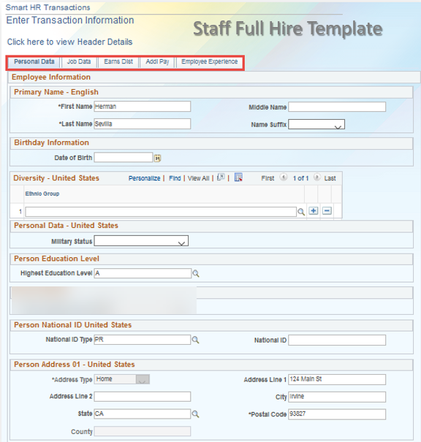
Enter Transaction Information Page
Enter the details for the hire on each tab.
You must navigate through all the tabs before the Save and Submit button is available.
When complete, click the Save and Submit button to submit the template for review and approval.
Full Hire – Staff Template Tabs include Personal Data, Job Data, Earnings Distribution, Additional Pay, and Employee Experience.
Notes:
The system steps are covered in more detail during the instructor demonstration and participant exercise.
The Employee Experience tab is replaced with the Person Profile tab for the Full Hire – Academic Template.
Remember funding is on the position not the person.

Slide 52

BREAK TIME
Break

Slide 53

Personal Data Tab

Slide 54
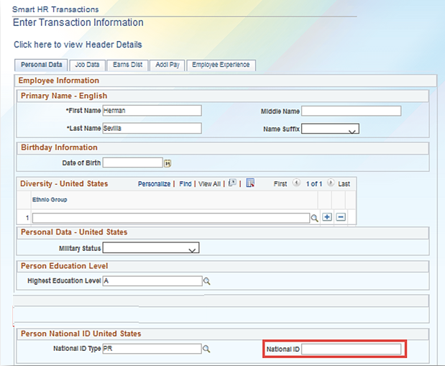
Full Hire Template – Personal Data Tab
Personal Data tab is the first tab on the hire template. It must be completed before you can proceed to the four remaining tabs.
The required fields are marked with an asterisk (*).
If National ID (SSN number) is not available at the time of hire it can be left blank and added later by the Initiator via UC Personal Data Smart HR Template.
The SSN verification process will be completed by the UCPC.
Notes:
Click for animation
Although no asterisk is present, the DOB or SSN is required for UCI. Failure to enter at least one of these items prevents the Identity Management system from checking for duplicates in UCPath.
Employees will have the option to self identify for their gender and sexual orientation via Employee Self Service.
If the Hire Effective date is in the future the system will allow you to submit the Hire Template without a Date of Birth. If the Hire Effective Date is the current date then DOB is required.
For hires without SSN the initiator places a note into the Template comments field that the employee has applied to ensure the processing of the transaction is not impacted, UCPC also reaches out to locations to retrieve missing SSN’s.
Fidelity IDs must be assigned to individuals who do not have a valid SSN (e.g., a foreign national who has applied for an SSN but has not yet received one) and are either eligible for the Savings Choice program, or were assessed retirement contributions in payroll and now those contributions need to be submitted to Fidelity for processing (e.g., DCP Safe Harbor). Once we receive the employees SSN we will add it into UCPath to ensure their record is updated.”
Most of the fields can later be updated by the employee via Self Service Portal. For more information on Personal Data Changes see Template Transactions Part 2 ILT training or refer to UCI Business Process Guide WFA.10 Personal Data Changes.

Slide 55
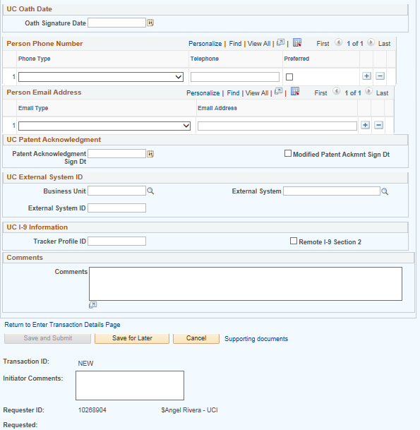
Full Hire Template – Personal Data Tab (cont’d)
This is the remaining part of the Personal Data tab.
Use the Person Phone Number and Person Email Address sections to enter personal contact information for an employee.
Please note that UCI directory will be integrated with UCPath so you do not need to enter work contact details in this section.
Enter UC Oath Signature Date.
Use the Comments field to enter specific details or an explanation regarding the transaction. This field is referenced by UCPC WFA Production to assist with the processing of the transaction. The comments entered here will become permanently part of the record.
Enter Patent Acknowledgment Signature Date.
Use the Initiator Comments field to enter additional information regarding the transaction for the location approvers and reviewers of the transaction. The information entered in this field will only be available while the transaction is being processed by the location.
Notes:
Click for animation
Here is additional information captured by the Full Hire Template.
For more information on Personal Data Changes see Template Transactions Part 2 ILT training or refer to UCI Business Process Guide WFA.10 Personal Data Changes.
UCI: Modified Patent Acknowledgment - Regarding the patent amendment, for all employees hired on or after November 1, 2011 the modified patent acknowledgement must be signed. If hired on or before October 31, 2011 the original patent amendment was signed. This group was required to sign an addendum to the original patent amendment.

Slide 56



Job Data Tab

Slide 57
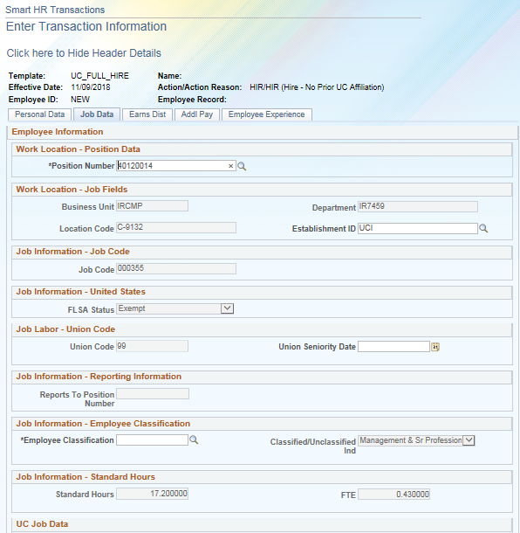
Full Hire Template – Job Data Tab
Once the Personal Data tab has been completed, proceed to the Job Data tab to search and assign a position number.
The position must already exist in the system before the hire template can be entered.
After the Position Number is entered, many of the other fields default and are view-only.
  For staff, the Employee Classification field does not default and must be manually entered.
  Employee Classification refers to Appointment Type in PPS. Please note that the associated numbers and options available have changed. Click on the look up box to see the full list of options available.)
For academic personnel, the Employee Classification field defaults and is view-only.
Standard hours and FTE also default from the position. Please see the next slide for further information on how to update position and job FTE.
Notes:
Click for animation
The Position must already be created in UCPath before the hire template can be initiated. If you do not know the positon number, the next slide will show you how to use the Advanced Search feature to look it up. Several fields default after you enter the Position.
They include:
Job Code
Standard Hours
FTE
Salary Admin Plan
Salary Grade
Employee Classification (for Academic employees)
Local Bargaining Unit (e.g. K9 and M9) Sal Plans are also loaded to UCPath. Other local scale plans would not be loaded to UCPath. Employees on these plans should not show a salary plan in their position.
All job codes are not used by all campuses. Each campus uses a subset of job codes. The Job Code determines the Salary Admin Plan and Salary Grade (that is entered on the Position). Some Job Codes do not have any established Salary Plans.
For many Job Codes a Step must be entered to populate the compensation fields. Stepped positions are largely represented staff and a majority of the academic positions. If the salary plan is open range, there are no steps available to select.
If steps are not applicable for the Job Code, the compensation fields must be manually entered. If the job includes half-steps, use the Step field Look Up button to review the Step Description and Hourly Rate to ensure you are selecting the appropriate step value.
There are some cases where there are no salary plan options to select – this could be because the job code is intended to have a negotiated (by agreement) salary.

Slide 58
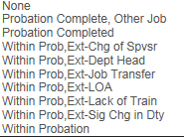
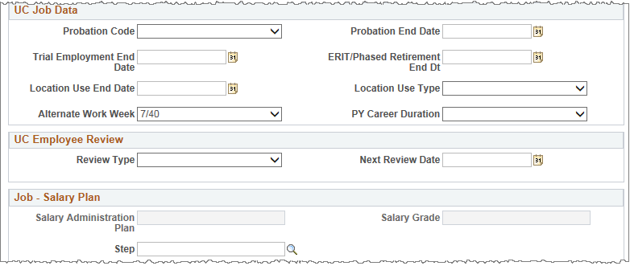


Full Hire Template – Job Data Tab (staff)
This is the continuation of the Job Data tab. As mentioned earlier separate hire templates are available for academic and for staff full hires. Some fields on UC Job Data Section are different for staff and academics. The example below includes a staff version of the section. Both templates are covered in the UPKs hire simulations.
Enter the Probation End Date and select the relevant Probation Code from the drop down menu. See below for the list of available options.
Probation Code
Enter the relevant Trial Employment End Date if applicable.
ERIT/ Phased Retirement End Date should be left blank.
Alternate Work Week displays any alternate schedule the employee is working.
Select the Review Type for which the employee is eligible. See below for the list of available review types.
Location Use Type and associated End Date are optional fields designed for local reporting use only. They fulfill the requirement for locations to track end dates per job record that may relate to funding, etc. An example of this might be setting a reminder for the expiration of contract/grant funds. See below for the list of options available under Location Use type.
Review Types
Location Use Type
Salary Administration Plan and Salary Grade default from position. The Step can be entered manually for staff.
Notes:
Click for animation

Slide 59

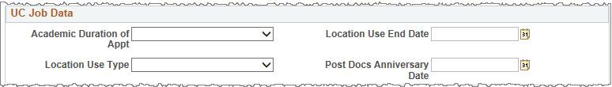
Full Hire Template – Job Data Page (Acad.)
The example below shows the UC Job Data Section for an Academic full hire. For more information and detailed steps for the academic hire see the UPK “Initiate Full Hire Template Transaction (Acad)”
Academic Duration of Appt.
Select the appropriate Academic Duration of Appt. from the list. See left for the list of available duration types.
Location Use Type and associated End Date are optional fields designed for local reporting use only. They fulfill the requirement for locations to track end dates per job record that may relate to funding, etc. An example of this might be setting a reminder for the expiration of contract/grant funds. See right for the list of options available under Location Use type.
If applicable use this field to enter Post Docs Anniversary Date.
Location Use Type
Notes:
Click for animation

Slide 60

Entering Compensation

Slide 61
Compensation Details
Many employees have only one pay component, but others may have components like Off Scale or Negotiated/Incentive Components.
There are certain job codes for which the pay itself is expected to be a flat amount (paid out as additional pay via PayPath Actions).
  In these situations, the compensation section in Job Data is left blank.
  This keeps the employee in a pay group that is considered payable so additional pay can process the flat dollar amount.
There are other employees in non CWR titles who will not receive compensation from UC.
  These employees have a comp rate of UCWOS (without salary).
  This places them in a pay group that ensures payroll is not processed for them.
For more information on Additional Pay and Without Salary, please refer to the PayPath Part 1 course.

Slide 62
Salary Admin Plans & Steps
When a position is created, the Salary Admin Plan is derived based on the job/title code.
The Salary Admin Plan drives what salary steps will be available to choose on Smart HR Template during the hire process.
If the salary admin plan was not identified, or is not available on the position, the salary step field in the job data tab will be uneditable.
When no salary step is available on the template, compensation rates must be entered manually, or the position must be fixed prior to entering hire.

Slide 63
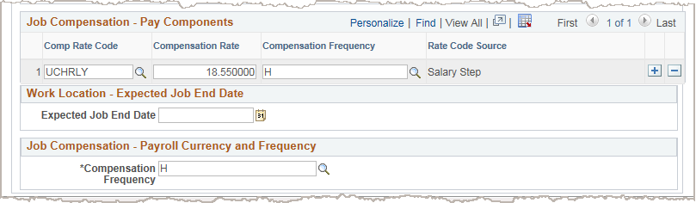
Pay Components – Comp. Frequency
Employee Compensation is identified on the Job Data tab.
Comp Rate Codes are used to define each component of the employee's base salary.
Compensation Rate is the amount paid at the compensation frequency.
In the Job Compensation - Pay Components section the Compensation Frequency field defines how the quoted compensation amount is presented:
A = Annual amount
H = Hourly amount
In the Job Compensation - Payroll Currency and Frequency section the Compensation Frequency field defines how the total compensation is actually paid out to the employee per paycheck.
For example, Monthly, Hourly, 9/12, 1/10.
This field defaults from the job code and can be overridden if there is a need to sync up pay cycles between two or more jobs.
Notes:
Click for animation

Slide 64
Negotiated Salary Trial Program (NSTP)
When hiring a Faculty member on Negotiated Salary (NSTP), their Comp Rate code needs to be identified as UGCGYN.
This custom Comp Rate code has been configured to accurately calculate NSTP for faculty.

Slide 65
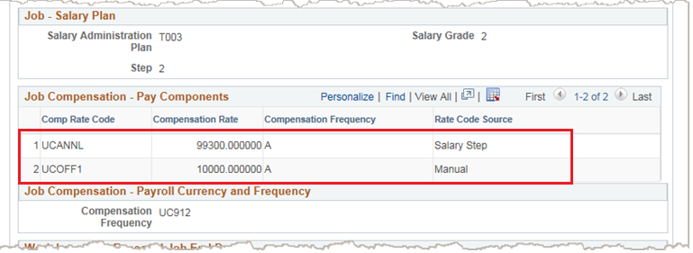
Multiple Components of Pay (MCOP)
Staff employees: there is very little need for MCOP (outside of Staff Physicians).
Academic Personnel: MCOP is more frequent, especially if the employee is in the Health Sciences Comp Plan (HSCP) or Negotiated Salary Trial Program (NSTP), which also has a base and incentive component.
1
2
Notes:
Faculty who are paid off-scale will have two compensation pay components in UCPath (vs. the one they currently have in PPS).
One line will show the scale amount ("salary step"),
and the other line will show the off-scale amount ("manual") in the Rate Code Source column.
Please refer to the MCOP training for additional guidance on using the multiple components of pay worksheet.

Slide 66
Academic Contract Pay – Overview
Contract Pay in UCPath pays faculty, or other academic employees, who must be paid a set amount over a period of time. Only employees paid Academic Year (AY) use Contract Pay.
  Even though they are normally hired and paid AY, 9/9 or 9/12, when they are placed on Contract Pay, their monthly Compensation Frequency is updated to C.
  Fiscal Year employees do not need Contract Pay because their pay is automatically prorated and/or retro-payments can be made.
Contract Pay can be requested using a template transaction during hire, rehire or transfer.
Contract Pay compensation can be quoted in two ways:
  Where the employee is entitled to receive the full annual rate per the Salary Step.
  Where the annual rate is manually prorated and entered as an override on the template.
You must enter a Comment on the template to indicate contract begin and end dates.
Notes:
If hiring someone for 2/3 quarters, Contract Pay is used to pay the same annual amount, but this amount is spread across the time period they are working (i.e. late hire, visa issues)
If an academic hire does not line up with a full academic year, there are still options outside of contract pay to pay them accurately. We can still pay faculty 9 over 9 (instead of 9 over12) if they start cleanly at the beginning of the quarter.
Contract pay should be used for 2 scenarios:
Full year pay over a truncated timeline
Prorated pay due to a late start.
Once July 1 starts the employee is on the full academic schedule.

Slide 67
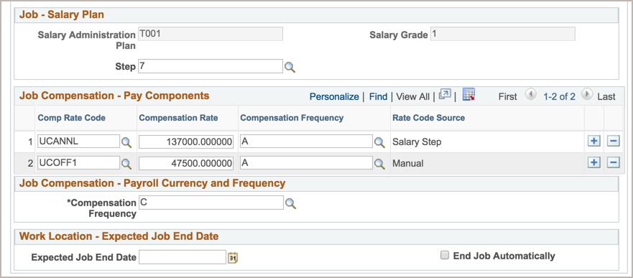
Contract Pay – Full Rate Sample
  When the employee is entitled to receive the full annual rate the template entry might look like this:
The Step entry defaults the UCANNL Comp Rate Code and the Compensation Rate.
The UCOFF1 amount may also added.
The Compensation Frequency is C.
Notes:
For comp rate codes, when you put in the Step, the code defaults, if no Step, you can see all the codes in the dropdown menu.
If an employee starts late, the following year they will be on the correct full year schedule-- can complete a PayPath transaction to initiate this change

Slide 68
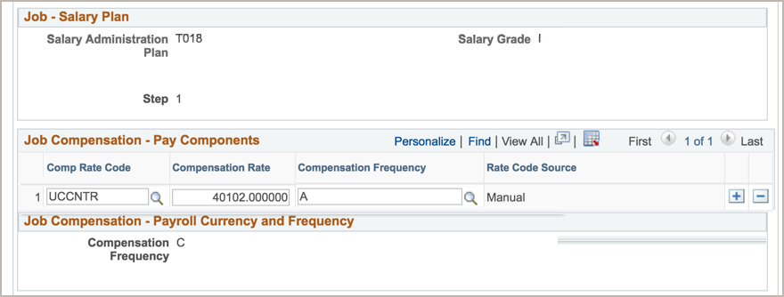
Contract Pay – Prorated Sample
  When the employee is entitled to a prorated annual rate the template entry might look like this:
The Comp Rate Code was manually entered as UCCNTR. This allowed the Location to prorate and manually update the Compensation Rate.
The Compensation Frequency is C which allowed the Location to override the Comp Rate Code.
Notes:
The importance of the compensation frequency field is that this tells UCPC how to calculate the employee’s pay per the frequency.
For Example, if the employee is an hourly employee with a specific rate, the frequency will show H. For C, this is showing that the rate is contract and will be paid based on the specified contract rate. This field will default based on the Position number you select.

Slide 69


Expected Job End Date

Slide 70
Expected Job End Date
The Expected Job End Date is required for the employee groups listed below. These employees will be automatically terminated upon the expected job end date entered if the End Job Automatically checkbox is checked.
Type | Description
Staff Employees | Contract Limited Student Floater Rehired Retiree
Academic Employees | Contingent Worker – Academic Non-senate academics, the general groupings include: Specialists Project Scientists Professional Researchers Postdoctoral Scholars Unit 18 Lecturers (otherwise known as Non-Senate Faculty (NSF)) Academic Coordinators Academic Administrators Visiting Titles UNEX Teachers Student Academic Titles Academic Recalled Employees Non-tenured Professors (Clin X, In Residence, HS Clinical, Adjuncts) Lecturers with Potential Security of Employment
Notes:
This for the non-senate academics generally includes every academic except for those that are tenured, continuing lecturers, and Lecturers with Security of Employment.
For more information on job end date use and monitoring please see the UCI BPG WFA.07 Job Record End Date Monitoring

Slide 71
Expected Job End Date Field – Staff
For short term assignment or temporary hires, enter the date the position ends in the Expected Job End Date field.
  Non-Academic employees are automatically terminated in UCPath on this date.
Locations must monitor expected job end dates and, if needed, update/extend the expected job end date (in PayPath Actions) to ensure the termination does not occur.
A report will be available to help with Expected Job End Date monitoring.
Notes:
When an employee is automatically terminated there is no need to submit the Termination Template. UCPC will process the termination based on the Expected Job End Date. Final Pay may still be required, please see Additional Compensation and Pay Adjustments ILT training for more information.

Slide 72
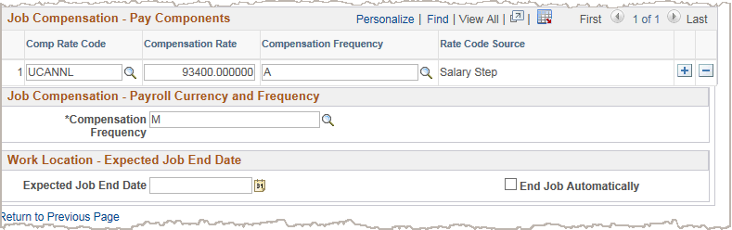
Expected Job End Date – Academic
For Academic hire templates, the End Job Automatically check box appears next to the Expected Job End Date field.
  Select the check box to automatically terminate the employee on the Expected Job End Date.
  If the check box is not selected, the employee is not automatically terminated.
Notes:
Although the employee is not automatically terminated on this date, there are many PayPath transactions UCPath will not allow you to do until the Expected Job End Date is extended.
An expected end date should be entered for the following academic employee classes:
3-Academic Recall
9-Faculty
10-Non-Faculty
11-Academic Student
14-Academic Contingent Worker
21-Emeriti
22-Deans/Faculty Administrators
23-Post Docs

Slide 73
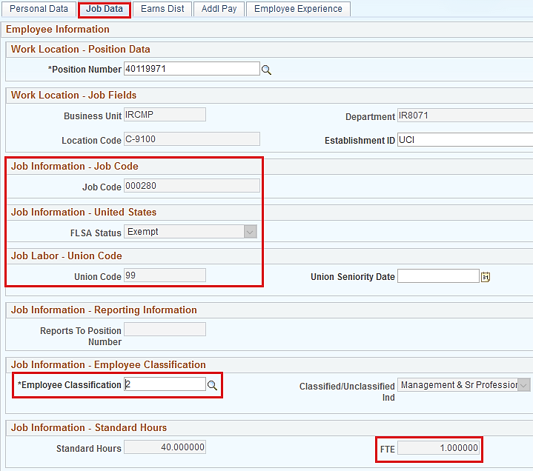

Benefits Eligibility Overview
Benefits Eligibility is a system-driven, custom process that analyzes and determines eligibility using job data fields. Multiple jobs, if applicable, are combined and analyzed as a whole to determine benefits eligibility. The following information is reviewed for all jobs in an employee’s record:
Job Code attributes
Employee Classification (Empl Class)
Appointment Duration,
if applicable
Full Time Equivalent (FTE)
  Be aware that system notifications (emails) are automatically sent to employees after benefit eligibility and self service events are finalized for the employee and the overnight batch process completes.
Notes:
Click for animation
BELI is no longer entered, it is system derived in UCPath.
Examples of Empl Class are:
Staff: Contract
Staff: Career
Staff: Limited
Staff: Rehired Retiree
Once template transactions are processed and finalized by the UCPath Center, Benefits Eligibility process is automatically triggered in UCPath via overnight batch process.
The Initiator does not have to do anything. The system handles this entire process.
Note: If there is some reason to add a status qualifier, e.g. grant ends sooner than a year, appt will be extended, but the intent is to provide benefits to the employee now, then the comments section should be used to inform the UCPC since the system will derive no benefits v. your intent of medical or full benefits.

Slide 74

Earnings Distribution Tab

Slide 75
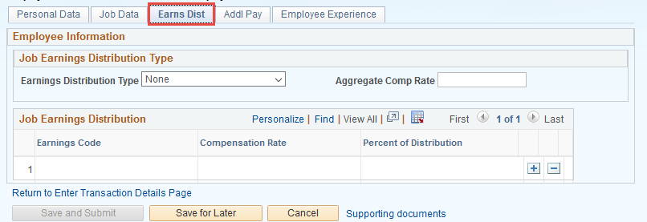
Job Earning Distribution Tab
Job Earnings Distributions (JED) tab can be used to indicate the compensation should be paid using a different Earn Code other than REG. For example, ACR or NNC.
Notes:
The implication of Job Earnings Distribution, which you may hear referred to as JED, is that an employee's funding can be distributed to different sources.
This mostly happens for employees that have the Health Sciences Comp Plan (HSCP) or NSTP (Negotiated Salary Trial Plan).

Slide 76
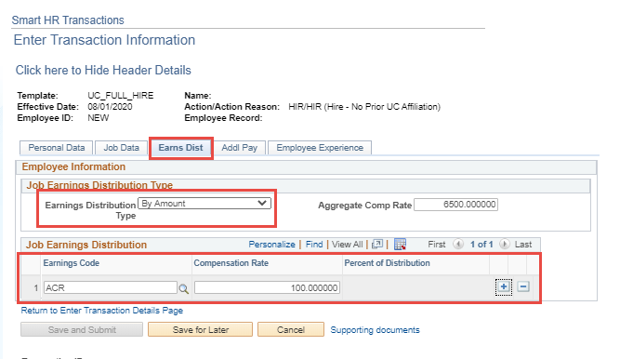
Job Earnings Distribution (cont’d)
Job Earnings Distribution (JED) is mostly automated and populates distributions By Amount or By Percent in the Job Earnings Distribution section.
Earnings Distribution type should be “By Percent”.
Notes:
For the most part, data entry for Earnings Distribution tab is automated; however, the Initiator can enter distribution information manually, if needed.
For manual entry, the Initiator must select either By Percent or By Amount for Earnings Distribution Type field.
If By Percent is selected , then percentages entered for all rows must add up to 100%.
If By Amount is selected, then amount entered for all rows must add up to Aggregate Comp Rate.
JED also can be requested for employees through PayPath Actions, for the following examples:
Employee Reduction in Time (ERIT)
HSCP-related automated JED by Earn Code
NSTP-Negotiated Salary Trial Program

Slide 77

Additional Pay Tab

Slide 78
Additional Pay & Smart HR Templates
Until further notice, DO NOT provide additional pay for new employees via a Smart HR Template.
There is currently a defect that fails to process and pay additional pay identified on Smart HR Hire Template transactions.
Users will need to submit the hire template without any additional pay data, wait until job record is created by UCPC, and then submit the additional pay request via a PayPath Action.

Slide 79

Other Tabs

Slide 80
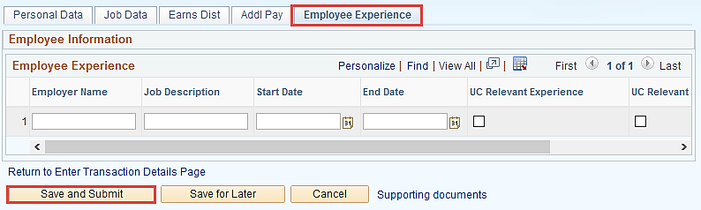
Staff Template – Employee Experience
The last tab of the Full Hire template for Staff Employees is called Employee Experience.
Use the fields on this page for represented staff to enter data related to the employee's prior work experience. Recording this information in UCPath is helpful in determining new compensation rates for the new hire.
The information entered in the Employee Experience section is copied to the employee's UC Employee Experience page after the template is fully processed by UCPC WFA Production.
Notes:
If you missed any of the tabs the Save and Submit button will be grayed out. Even if you do not have information to enter you must click all tabs to submit the template transaction.

Slide 81
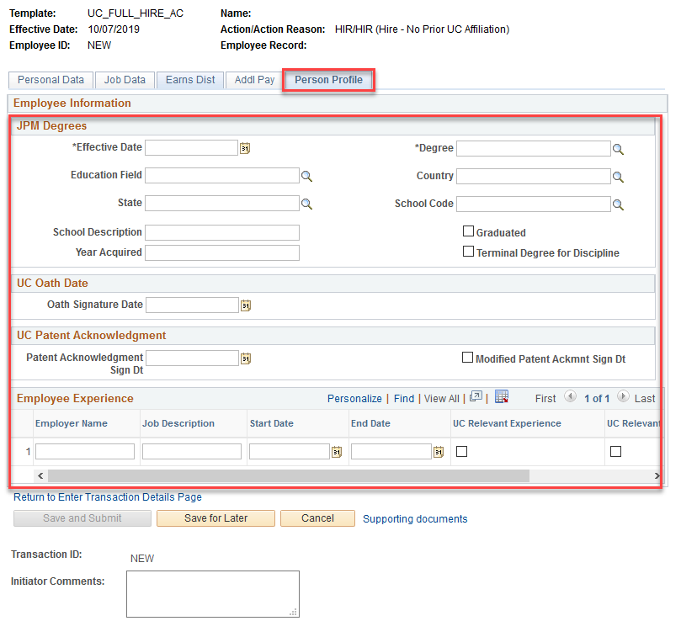
Academic Template – Person Profile
The last tab for the
Full Hire Academic template is called the Person Profile.
It is used to record Degree information and Oath & Patent signature dates.
Effective Date is the date of the entry not the degree.
DO NOT CLICK IN THESE FIELDS
Caution: If you click any field in this section, all fields will become required.
Notes:
This last tab is different depending on whether it’s a staff or academic hire.
If an Academic Employee adds Degree information, it will not be automatically added to their profile until approved by other department-- this information will be used for reporting to UCOP
The Effective Date for Degrees is usually the date of Hire, Rehire or first time the Degree is being entered. There is a different field that captures when the employee obtains the degree.

Slide 82

Onboarding / I-9 Verification

Slide 83
Tracker & I-9 - Overview
Tracker is used across UC to manage the government form I-9 and administration of the E-Verify process. For Tracker to do this, the system requires data integration between Tracker and UCPath.
I-9 Information
From UCPath to Tracker:
  When an employee is hired, rehired, transferred (intralocation or interlocation) or terminated in the system, UCPath sends data real-time to Tracker using a webservice.
From Tracker to UCPath:
  When an I-9 has been completed in Tracker or when an employee who has a work authorization (subject to expiration) updates their work authorization, certain pieces of data return to UCPath real-time using webservice.
Notes:
One of the main pieces of information being shared between UCPath and Tracker is the employee’s SSN.

Slide 84
I-9 Information in UCPath
The HR Worksite ID on the Position, determines how i-9 verification is processed. If the position was created with:
  UCI E-Verify Required: System-generated i-9 notification sent to employee once hired.
  UCI No E-Verify: School/Department/Central onboarding performs manual i-9 verification.
  Once the hire is processed and the i-9 verification process has been completed, UCPath system copies the Tracker Profile ID to the employee’s UCPath Person Profile page.
  The Tracker Profile ID links UCPath with Tracker and allows the I-9 information entered in Tracker to be interfaced.
Notes:
This process applies to departments that do not use people services for their new hire onboarding.

Slide 85
Central UCI Onboarding
People Services collaborates with UCI Schools & Departments to provide onboarding services for newly hired employees.
People Services will initiate the i-9 verification process with the employee and provide the Tracker Profile ID number.

Slide 86

Happiest of Paths for I-9
There are three scenarios that can occur when providing the Tracker Profile ID to UCPath:
  Scenario 1: If tracker is completed prior to initiating the template transaction, the initiator must obtain and enter the Tracker Profile ID manually into the SMART HR Template when completing it.
  Scenario 2: Initiator submits the SMART HR Template with an SSN, once the template is approved Tracker sends the employee a link to go into Tracker to setup a profile and complete information. Tracker then updates UCPath with the Tracker Profile ID.
  Scenario 3: Initiator submits a Pre-Hire using the SMART HR Template but does not provide an SSN. In this scenario Tracker may not have the information needed to send an email link to the employee. So the Initiator will have to go Tracker to obtain the Tracker Profile ID as well as go into UCPath (PeopleSoft Menu > Personal Profile > UC I-9 Information tab) after the employee is hired to add the Tracker Profile ID.
Notes:
Scenario 1: If tracker is completed prior to initiating the template transaction, the initiator must obtain and enter the Tracker Profile ID manually into the SMART HR Template.
Scenario 2: Initiator enters the SMART HR Template with an SSN, once the template is approved Tracker sends the employee a link to go into Tracker to setup a profile and complete information.
If the SMART HR Template is completed prior to entering the Tracker Profile ID, once the template is approved a notification automatically goes to the employee with a link to go into Tracker Once section 2 or 3 is completed in Tracker; it sends information back to UCPath OR
As long as the SSN is entered on the hire template, Tracker is able to match the Tracker Profile ID (when created) with the employee in UCPath.
Scenario 3: Initiator submits a Pre-Hire using the SMART HR Template but does not provide an SSN. In this scenario Tracker may not have the information to send an email link to the employee. So the Initiator may have to go into Trackerwill have to go into Personal Profile >UC I-9 Information tab afterwards to add the Tracker Profile ID.
In the case of a Pre-hire where the SSN is not entered in the hire template, Tracker will be unable to make a match in UCPath.
This scenario simply involves more manual intervention than the other two scenarios.

Slide 87
Additional Types of Hires
Academic employee with an off-scale component
Without salary appointment
With salary paid as Additional Pay
(e.g. recreation program instructors)
Someone with negotiated salary only
(e.g. coaches in Athletics)
An employee with NSTP
Volunteer
Retro Hire
Student on Work Study

Slide 88
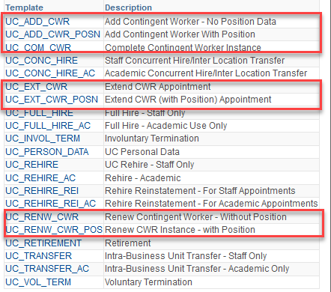
Contingent Worker (CWR) Templates
CWR templates with or without a position
Add a CWR
Extend a CWR
Complete a CWR*
  *Only one template; not a separate template for a CWR w/ position
Renew a CWR
Notes:
All of the CWR templates have a version for with a position and one for without a position with the exception of the Complete a CWR template.
The Add a CWR templates are used to “hire” contingent workers. If the person will have UCI employees reporting to them, then the UC_ADD_CWR_POSN version of the template should be used. This ensure that CWR will have access to their direct reports via Manager Self Service, if needed.
The Extend CWR templates are used to extend the appointment of a contingent worker. Again, you should use the version that corresponds to whether or not they as in a position or not.
The Complete CWR template is used to terminate the appointment of a contingent worker. There is only one version of this template.
The Renew CWR templates are used to “rehire” a contingent worker who had a previous appointment. Again, you should use the version that is appropriate depending upon if they will have direct reports or not.

Slide 89
Templates – Additional Notes
Allow approximately 7-10 business days for new hires to be processed at the UCPath Center
Remember: Effective Date is equivalent to the employee’s first day on the job.
Once the template has been processed by the UCPath Center, PayPath Actions are then used to make changes and manage employees’ job data.
Probation status Salary Compensation | Job earnings distribution Recurring additional pay Appointment End Date
Notes:
Immediately after go-live it is recommended that you submit transactions that require UCPC AWE approval at least 2 weeks (14 days) in advance to account for mistakes or templates being returned and re-processed.
For more information on PayPath refer to UCI PayPath Transactions Part 1 and Part 2 ILT courses.
Please note that the probation status needs to be updated manually upon completion.
______________________________________
Originally on slide….
Any future changes to employee’s job data, including probation status, salary, compensation, job earnings distribution and recurring additional pay can be done via PayPath:
Navigation: PeopleSoft Menu > UC Customizations > UC Extensions > PayPath Actions
Any future changes to employee Personal Data can be made via Smart HR Template Personal Data (see UCI Template Transactions Part 2 course for more information).
Effective Date?yes

Slide 90
Instructor Demo UPK
Initiate Full Hire Template Transaction
This is your opportunity to view this task on your own.
  Open the UCPath Help site and refer to the Initiate Full Hire Template Transaction simulation
Launch the See It! version of the topic.
Ask your instructor for assistance.
Notes:
For UPK simulation-based exercises, instruct the users to open the See It view and complete the task.

Slide 91
Lesson Complete
Having completed this Lesson, you should be able to:
Identify the data elements of the Smart HR Hire templates.
Understand how job data is created using combination of positon and person data.
Understand what is required to process a Pre- Hire.
Recognize the steps to view and assign vacant positions .

Slide 92
Lesson Review
Knowledge Check:
You now have the opportunity to assess your knowledge of the information presented in this Lesson.
The questions and answers presented in this review help you to determine whether you remember and understand the important points.

Slide 93
Multiple Choice
Which template is used to hire new Staff Employees?
UC_ADD_CWR
B. UC_FULL_HIRE_AC
C. UC_FULL_HIRE
D. UC_ADD_EMPLOYEE

Slide 94
True or False
An approved position must exist in UCPath before submitting a Smart HR “Hire” template.
True
False

Slide 95
True or False
Position details auto-fill in the Smart HR Hire template when a position is entered or selected.
True
False

Slide 96
Fill-In the Blank
___________ process is defined as a hire transaction submitted well in advance of the employee’s start date. This may help ensure credentials and system access has been established by their first day on the job.
Pre-Hire

Slide 97
PART 2
Concurrent Hire

Slide 98
Lesson Objectives
Template Transactions Overview
Approvals and Status
Full Hire
Concurrent Hire
In this lesson you will:
Describe the steps in the approval process.
Learn about the approval workflow cycle.
Look up the status of a template transaction transaction.

Slide 99
Concurrent Hire - Overview
Concurrent Hire template is used when an additional job, or employment record, is added to an existing employee’s profile.
Concurrent hire template can be used to hire an employee from another location
Can be used for employees working in multiple locations at the same time.
  Example: Dual Employment
Do not use concurrent hire template for an employee who has had a gap in service.

Slide 100
Concurrent Hire Templates
Concurrent Hire:
A staff or academic employee adds an additional job, which is concurrent to his or her existing job with UC.
A separate concurrent hire template is available for academic and for staff.
Concurrent hire templates are also used for interlocation transfers.
Interlocation transfers are covered in the course Template Transactions - Part II.
Available Templates
Notes:
In UCPath one job record can be created at a time. Once the first job has been created and approved and the employee ID has been generated, the second job can be added.
Additional Info:
Non-Dual: Two or more jobs that do not exceed a total percent time of 100%.
Dual: Two or more jobs that exceed a total percent time of 100%. Applies to staff Empl Classes only and occurs through additional job that is separate from any other job an employee holds.

Slide 101
Concurrent Hire – Key System Steps
Review Person Org Summary page
Navigate to Smart HR Transactions page
Select the Concurrent Hire template
Click Save & Submit for Review and Approval
Enter concurrent hire details and attach supporting documentation as needed
Determine if changes need to be made.
Notes:
Concurrent Hire Template Transaction key system steps.
Access the Person Org Summary page before initiating a concurrent hire template transaction to gain an understanding of the employees current assignments.
Navigate to the Smart HR Transactions page.
Select the appropriate concurrent hire template: Academic or Staff.
Review the employee’s personal information (any personal data changes should be submitted using the personal data change template or through self service.) Add the concurrent job information, JED and additional pay as needed. Also add attachments, if needed.
Comments for the approvers should be entered in Initiator Comments field. Any information that is meant for UCPC WFA Production, and cannot be entered in one of the existing fields, are entered in Comments field.
When the transaction is complete, select the Save and Submit button.
After the Initiator saves the transaction, it is automatically routed for approval using AWE. A designated Location Template Approver reviews and, if applicable, approves the transaction. After AWE, the template is staged until it is processed by UCPC WFA Production.
There may be multiple AWE Approvers depending on your Location’s business process.

Slide 102


Types of Concurrent Hires
Inter-location
(Multiple-Location)
across multiple Business Units*
Intra-location
within Business Units**
* For the purpose of the Intra-location Concurrent Jobs process UCI Campus and Medical Center are considered one Business Unit.
*Business Units refer to individual UC Locations (ex: UCLA to UCI)
Notes:
There are two types of Concurrent Hires – Inter and Intra-location.

Slide 103





Multi-location Jobs
Multi-location jobs are when an employee works for two or more UC Locations simultaneously (e.g., UCI and UC San Diego)
As an employee can only be paid by one location, when an employee is employed by 2 or more locations at once, one location is designated as the "Home" location. The non-Home location is considered the "Host" location.
HOME
HOST
Receiving Location
(the location adding employment to existing job record. )
UCI
(where the primary job exists)
Notes:
As an employee can only be paid by one location, if an employee is working at 2 or more locations at once, one location is designated as the “Home” (originating) location. The non-Home location is considered the “Host” (receiving) location.

Slide 104
Multi-location Jobs Process Overview
Process Overview for Inter-location Hires when both locations are on UCPath.
The Host location intends to Hire a current UC Employee
The Host location completes MLA using Person Org Summary and Host job information
The Host location sends MLA to Home Location
The Home Location initiates any required data changes based on discussion with Host Location
The Home Location approves and sends MLA to Host location
The Host Location initiates a Smart HR template for Concurrent Hire with approved MLA

Slide 105
Multi-Location Agreement Form (MLA)
If a concurrent job is between multiple Locations, the Host Location must complete a Multi-Location Agreement (MLA) form and have it signed by the Home location.
Host location will need to attach MLA to the concurrent hire template transaction.
Until all Locations are live on UCPath, use the following guidelines for new concurrent jobs between multiple Locations.
Host | Home | Receiving Location (Host) | Originating Location (Home)
UCPath | UCPath | Submit concurrent hire template with MLA attached. | Coordinate with receiving location and make any applicable data changes.
UCPath | PPS | Submit Contingent Worker template with MLA attached and use Job Code CWR017 (UC Employee-Different Business Unit). | Continue local process for data changes, if applicable.
PPS | UCPath | Complete MLA and send to originating Location. | No UCPath changes needed.
Notes:
Some Locations may have a system or process other than UCPath that is used to track the Multi-Location Agreement form.
If a concurrent job is between multiple Locations, the Location must complete a Multi-Location Agreement (MLA) form and attach it to the concurrent hire template transaction.
Until all Locations are live on UCPath, use the following guidelines for new concurrent jobs between Locations.

Slide 106

Intra-location Concurrent Jobs

Slide 107
Intra-location Concurrent Jobs
Refers to an employee having two jobs within the same Location (concurrent employment at UCI Campus or at UCI Campus & UCI Medical Center)
Receiving Department
(where the new job is being created)
Originating Department
(where the current job exists)

Slide 108
Intra-location Concurrent Jobs – Process Overview
This is a Business Process for Intra-location Concurrent Hires.
The Receiving Dept. intends to Hire a current UCI Employee
The Originating Dept. initiates any required data changes based on discussion with Receiving Dept.
The Receiving Dept. initiates Smart HR Concurrent Hire Template
The Receiving Department approves the template via AWE
UCPC processes the template

Slide 109
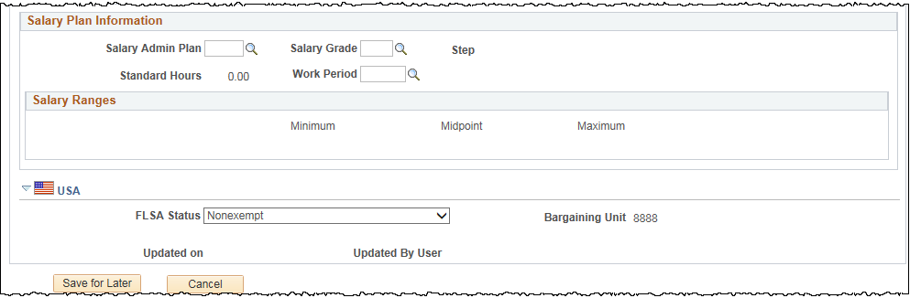

Concurrent Hire - FLSA Status Management
FLSA is an attribute of the position and defaults from the Job Code.
In UCPath an employee can only be assigned one FLSA status. When there is a need to change the FLSA due to the conflict when adding Concurrent Jobs the Units can contact Academic Personnel or Central HR for further guidelines. They will evaluate the jobs and decide what the FLSA status should be assigned. The FLSA Status can then be overridden as required via PayPath.
For more guidelines on updating the FLSA statuses visit:
  http://ap.uci.edu/compensation/flsa/ for academic employee or
  http://hr.uci.edu/partnership/flsa/ for staff
Notes:
There are 4 FLSA statuses available:
Exempt
No FLSA Required
Nonexempt
Nonexempt alt overtime (this value is used to track whether someone is eligible for an alternate overtime calculation, which is applicable for employees who are working in certain states that do not use the federal overtime guidelines)
The Initiators can check the FLSA status of the existing job on Person Organizational Summary page.
A report on FLSA status will be available to help the organizations manage FLSA status changes and highlight conflicts if they occur.

Slide 110
Concurrent Hires - Dual Employment
Concurrent Hire process also covers Dual Employment.
For Dual Employment, the additional appointment (job) is generally in another department.
  Applies to Academic appointments only.
  Additional appointment is separate from any other job an employee holds.
  Results in the employee working > 1.00 FTE (100%) in any given month.
  May occur in an employee’s home department only if the additional work is unrelated to their current job and the employee works under a different Job Code.
  Only permitted on an exceptional basis; central HR/AP approval is required.
  Multi-location Dual Employment (> 1.00 FTE) is never permitted.
  Location must provide authorization to UCPC for the dual employment, in the form of a Dual Employment form attached to the Smart HR Template.

Slide 111
Concurrent Hires – Additional Notes
It is the HOME department’s responsibility - where the existing job is located - to perform an analysis of the FTE (appointment percentage) to ensure the employee will not exceed 100% time for all jobs once the new job is added.
Coordination at the location level will be required for both jobs should adjustments be needed to:
  FTE
  FLSA Status (see the next slide)
  Benefits or leave accrual eligibility
  Probationary period status
  The 750 hour rule for Unit 18 lecturers
  Hours toward career status considerations
  Ongoing coordination of time and attendance

Slide 112
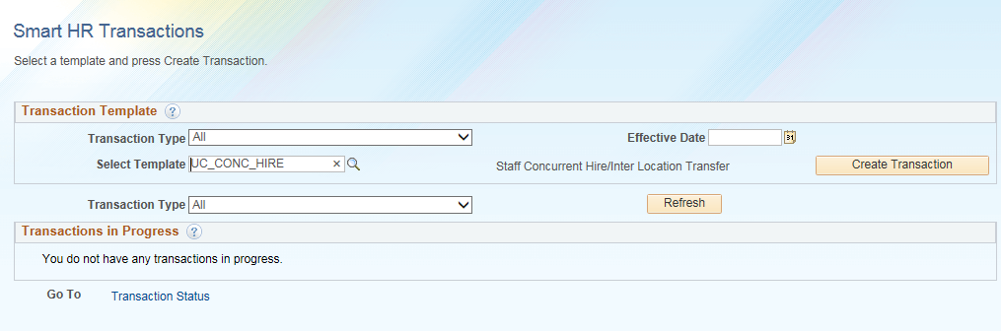
Smart HR Transactions Page
Navigation: PeopleSoft Menu > Workforce Administration > Smart HR Template > Smart HR Transactions
Enter the effective date of the transaction
Select the concurrent hire (staff or academic) template.
Click Create Transaction to begin entry of the template transaction.
Notes:
Click for animation
When displayed in Slide Show mode, this slide includes animation for the gray captions. Click to individually display each caption (and hide the previous caption) as you describe the objects on the Smart HR Transactions page.
This is the start page for any Template Transaction.

Slide 113
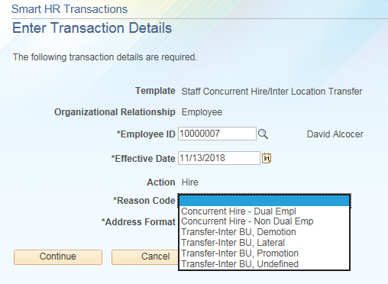
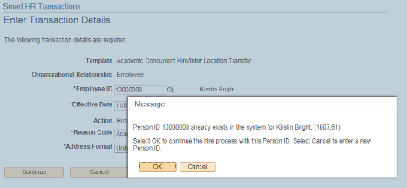
Enter Transaction Details Page
Enter the details for the concurrent hire, beginning with the Employee ID, Effective Date and the Reason Code.
Important
Ensure that you select the correct Effective Date and Reason Code. These fields are important entry points for the employee’s record and have many downstream effects.
Enter the employee’s current Employee ID.
Select the appropriate Reason Code.
Click Continue to enter the remaining details of the template.
Notes:
Click for animation
When displayed in Slide Show mode, this slide includes animation for the gray captions. Click to individually display each caption (and hide the previous caption) as you describe the objects on the Enter Transaction Details page.

Slide 114
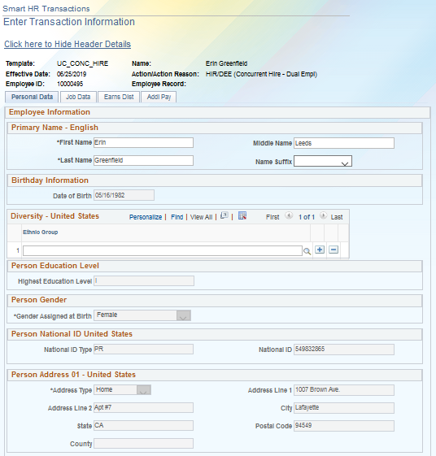
Enter Transaction Information Page
Some existing personal information is automatically populated.
Complete each tab, then click the Save and Submit button to submit the template for review and approval.
The Save and Submit button is available only on the “Additional Pay” tab.
Notes:
Any personal data changes should be submitted using the personal data change template or through self service.
The system steps are covered in more detail during the instructor demonstration and participant exercise.

Slide 115
Instructor Demo UPK
Initiate Concurrent Hire Template Transaction
This is your opportunity to view this task on your own.
  Staff: Open the UCPath Help site and refer to the Initiate Concurrent Hire Template Transaction (Staff) topic.
  Academic: Open the UCPath Help site and refer to the Initiate Concurrent Hire Template Transaction (Acad) topic.
Launch the See It version of the topic.
Ask your instructor for assistance.
Notes:
For UPK simulation-based exercises, instruct the users to open the See It view and complete the task.

Slide 116
Lesson Objectives
Template Transactions Overview
Approvals and Status
Full Hire
Concurrent Hire
In this lesson you will:
Describe the steps in the approval process.
Learn about the approval workflow cycle.
Look up the status of a template transaction transaction.

Slide 117
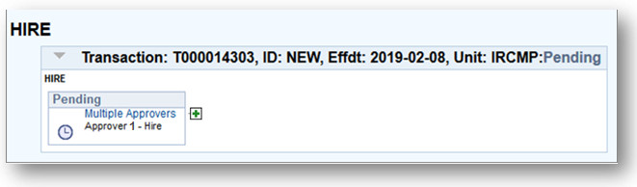
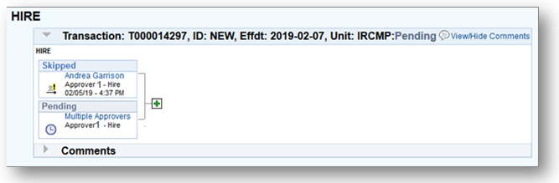
AWE Approvals
When a transaction is submitted by the initiator, AWE routes the transaction for review and approval.
AWE Dialogue box displays as Pending. Click “Multiple Approves” to see list of Approvers for that transaction.
Initiator is not an approver
The initiator is also an AWE approver. The initiator was skipped because initiators cannot approve their own transactions in UCPath.
Initiator is also an approver so they were skipped in the approval flow
Notes:
Click for animation
After a transaction is initiated, the transaction is automatically routed to the designated department Approver for review via AWE.
In the bottom image, because the initiator is also an approver, they were skipped and the transaction is routed to other approvers. The initiator can never approve their own transactions.
You may also click on the “multiple approvers” link in the dialogue box to display a list of approvers the transaction was routed to. All users listed will receive notification of pending action.

Slide 118
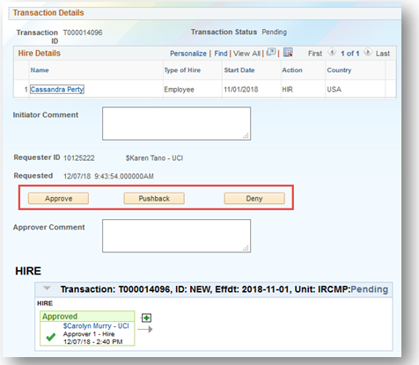
Location AWE Approver Options
1st AWE Approver (Approver 2)
Approve | Edit transaction, if needed and Route to the next level of approval* and/or Submit for processing by UCPC.
Deny | Enter comments and deny transaction. It routes back to initiator - no additions or changes reflected in UCPath.
2nd AWE Approver*
Pushback | Enter comments and push the transaction back to lower level approver (Approver 1).
*A second or third AWE approver can appear if an ad-hoc department approver adds another approver using the Ad-hoc functionality.
Notes:
The first approver can either approve or deny (with comments) the transaction.
If a transaction with multiple approvers is denied at level 2, doing a “Pushback” sends the transaction back to Approver 1 in the routing.
Approved template transactions become available for processing by WFA Production at the UCPath Center.
There will be an email notification sent to the initiator when transactions are approved or denied.
Depending on the type of template submitted, Approvers may have the ability to update or modify some of the details.
Transactions will not allow double approval, so if an approver clicks on an already approved transaction, there will be no action buttons available.

Slide 119
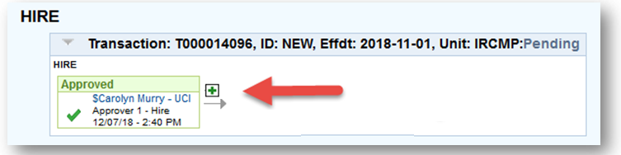
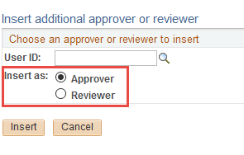
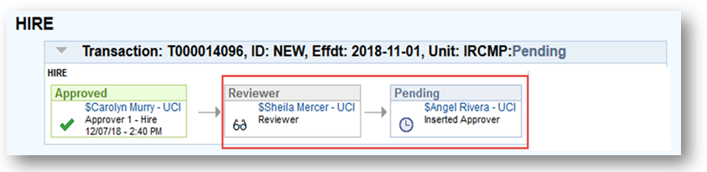
Ad-hoc Reviewers and Approvers
Additional reviewers and approvers can be added by accessing the Ad-hoc feature ( ) in the approval workflow.
Notes:
Click for animation.
Click twice to view animation fully.
Any of you can be an Approver and this will be covered in another class.
You can not approve your own submission.

Slide 120
AWE Notifications
Type of Notification
Transaction Status | Notification? | To Who?
Submitted | AWE Email | Initiator & Approver
Local Approval / Denial | AWE Email | Initiator & Approver
UCPC Approval / Cancel | AWE Email | Initiator & Approver
Pushback | UCPC Email | Email to Initiator & Approver
Notes:
When the transaction is submitted,
An email and Worklist notification is sent to all approvers selected at the first level.
When the transaction is approved at any level,
An email and Worklist notification is sent to all approvers selected at the next level.
When the transaction receives final approval,
An email is sent to the initiator.
When the transaction is denied,
An email is sent to the initiator, and an email is sent to any approver who had previously approved the transaction.
When the transaction is pushed back,
An email and Worklist notification is sent to all approvers selected at the level to which the transaction has been pushed.

Slide 121

Viewing Transaction Status

Slide 122
Transaction Status
Use the following pages to view the status of template transactions.
SS Smart HR Transaction Page – UCI
  Use to view template transactions and their status in the approval workflow. Use the assigned Transaction ID to search for and view template transactions within the Business Units for which you have access to.
PeopleSoft Menu > UC Customizations > UC Extensions > SS Smart HR Transactions
Transaction Status Page – UCPath Center
Use to view the status of template transactions that have began the approval workflow process to be completed by the UCPath Center WFA Production. This page allows you to search for and view template transactions you have submitted, as well as those in departments for which you have row-level security access to.
PeopleSoft Menu > Workforce Administration > Smart HR Template > Transaction Status
Notes:
There are 2 places to view a transaction status depending on whether it is in UCI approval or being processed at the UCPath center

Slide 123
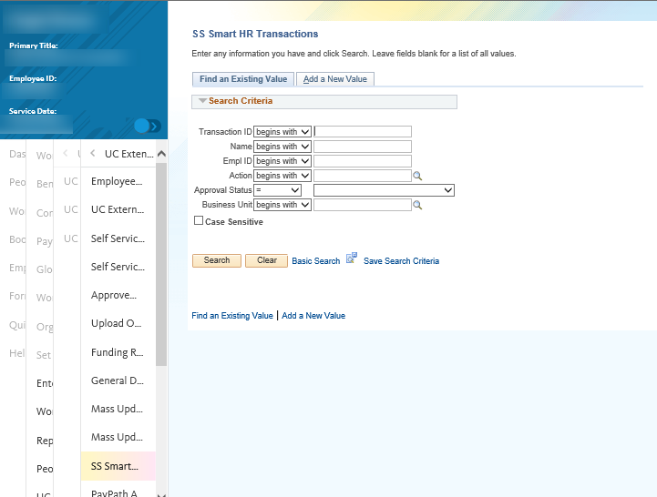
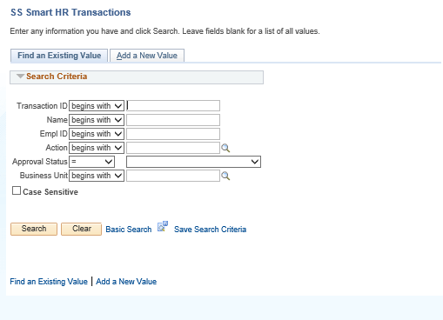
Option 1: SS Smart HR Transactions
Navigation: PeopleSoft Menu > UC Customizations > UC Extensions > SS Smart HR Transactions
Use the Transaction ID field to populate the transaction number. This would the most effective way to search on this page.
Notes:
To view the status of a template transaction that was submitted, use the SS Smart HR Transactions page.

Slide 124
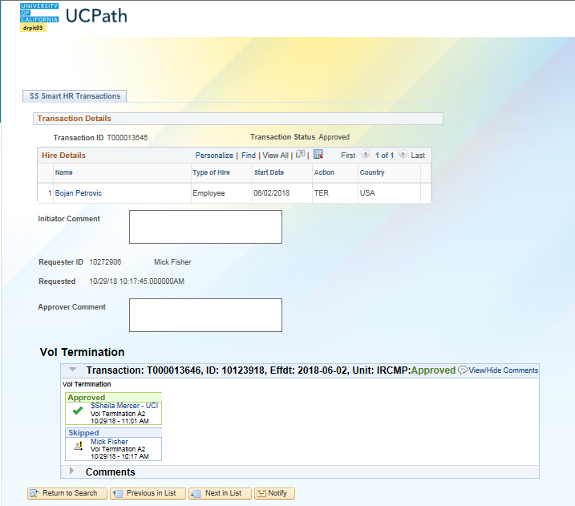
SS Smart HR Transactions Page
Use the SS Smart HR Transactions page to:
  View the template transaction details and where it is within the approval workflow.
  View transactions you have submitted along with all transactions submitted within your business unit.
  Review who the approvers are.
The status appears at the top of the page and also at the bottom of the page.
To view the template transaction details, click the Name link.
This section displays the Location approvers to which the transaction is routed. To display the specific Location approver name(s), click the Name/Approver link.
Notes:
Click for animation
When displayed in Slide Show mode, this slide includes animation for the gray captions. Click to individually display each caption (and hide the previous caption) as you describe the objects on the SS Smart HR Transactions page.
This is the same page that Approvers use to Deny or Approve a template transaction.

Slide 125

Option 2: Transaction Status Page
Navigation: PeopleSoft Menu > Workforce Administration > Smart HR Template > Transaction Status
Adjust the selection criteria as needed to filter the displayed transactions. Start Date From and To = effective date of the transaction.
Transaction Status values include: Requested, Completed, Hired/Added, Denied and Cancel.
If a transaction is cancelled, you can View Comments to see why it was cancelled, then Clone the existing template information into a new template, correct and submit.
You can also Clone transactions that have been denied by an Approver; however, you must review the comments from the Approver in the SS Smart HR Transactions page.
Caution: This button deletes the selected transaction(s) from the system, removing it from UCPC’s processing list.
Notes:
Click for animation
Review the Transaction Status page:
Select – Select the check box then click the Delete Selected Transactions for any transactions you want to delete from the system as well as delete from UCPC WFA Productions processing queue. A warning message appears to ensure you want to take this action.
Template – The template that was initiated.
Effective Date – The effective date of the template transaction.
Transaction Status – The current status of the template transaction.
Requested: Transaction completed AWE and is waiting for UCPC WFA Production to process.
Completed: Transaction was processed by WFA Production and saved into UCPath.
Hired/Added: Hire or rehire transaction was processed by WFA Production and saved into UCPath.
Cancel: Transaction was cancelled by WFA Production. View Comments to see the reason why it was cancelled.
Person ID – The ID of the employee (displays NEW for full hire transactions).
Empl Record – The employee record or job for which the template transaction is initiated.
Action – The action description for the initiated template transaction.
First and Last Name – The employee name for the requested template transaction.
Reason for Cancellation – A View Comment link displays for any template transactions that were cancelled by WFA Production so you can view the reason it was cancelled.
View Email Text – A View link displays for any template transactions that WFA Production sent an informational one-time email to the Initiator. The View link displays the text of the one-time email.

Slide 126
Transaction Status Page (cont’d)
Use the Transaction Status page to:
View the status of the template as it goes through the queue at UCPC (WFA Production).
    This page tracks the status of templates after approval at the Locations.
View the Person/Empl ID that was generated for new hire transactions.
View transactions you submitted along with all transactions for departments for which you have security access.
Clone a transaction that was cancelled by UCPath Center.
View transaction notes sent by UCPC WFA Team.
Notes:
Anyone with access to the department can use the Transaction Status page to view the status of template transactions. It is not restricted to just the Initiators.

Slide 127

Cloning a Denied Template

Slide 128
Clone a Template
You can clone a template transaction if that transaction has been DENIED by UCI or CANCELED by the UCPC.
When a template has been denied or canceled:
  There should be comments from the Approver or the UCPath Center explaining why, or what needs to be corrected.
  A system generated email notification is sent to the Template Initiator when a template has been denied or canceled.
Access the Transaction Status page to view the status of transactions, review comments and clone the template that was denied or cancelled, if applicable.
Notes:
UCPC does not DENY transactions instead they CANCEL transactions. In some cases when a transaction is denied or canceled, it can be CLONED and resubmitted. However, if the transaction was submitted using the wrong template the initiator will have to start over from scratch using the correct template.

Slide 129

Clone Template – Transaction Status Page
Navigation: PeopleSoft Menu > Workforce Administration > Smart HR Template > Transaction Status
You can clone transaction that display a Transaction Status of Cancel.
You can View Comments to see why it was cancelled, then Clone the existing template information into a new template, correct and resubmit.
Notes:
Click for animation
When displayed in Slide Show mode, this slide includes animation for the gray captions. Click to individually display each caption (and hide the previous caption) as you describe the objects on the Transaction Status page.

Slide 130
Instructor Demo UPK
Clone Template Transaction
This is your opportunity to view this task on your own.
  Open the UCPath Help site and refer to the Clone Template Transaction topic.
Launch the See It version of the topic.
Ask your instructor for assistance.
Notes:
For UPK simulation-based exercises, instruct the users to open the See It view and complete the task.

Slide 131

Lesson Complete
Having completed this Lesson, you should now be able to:
Understand how the Approval Workflow process works.
Navigate to Transaction Status pages to view the latest status of your template transaction
Clone a denied or cancelled hire template / transaction

Slide 132

Lesson Review
Assessment
You now have the opportunity to assess your knowledge of the information presented in this Lesson.
The questions and answers presented in this review help you to determine whether you remember and understand the important points.

Slide 133
True or False
A concurrent hire is when a staff or academic employee adds an additional job, which is concurrent to his or her existing job with UC.
True
False
Notes:
Click for animation
Correct Answer is: True

Slide 134
Fill-In-The-Blank
Person Org Summary
Access the ____________________ page before initiating a concurrent hire template transaction to gain an understanding of the employees current assignments.
Notes:
Click for animation
Correct Answer is: Person Org Summary

Slide 135
Lesson Completed
Having completed this Lesson, you should now be able to:
Describe the key system steps to complete a concurrent hire template transaction.
Initiate a concurrent hire template transaction.

Slide 136

Course Resources

Slide 137
Reference Material for Review
Links to Helpful Reference Material:
http://www.hr.uci.edu/ - UCI HR Website
https://ap.uci.edu/ - UCI Academic Personnel Website
http://www.uclc.uci.edu/ - UC Learning Center Website
https://ucpath.uci.edu/training/index.php - UCI UCPath Training Website
List of Other Relevant UPKs:

Slide 138
Course Summary
The Smart HR Transactions page is the starting point to initiate HR template transactions.
Refer to the Template Transactions User Guide for guidance on selecting appropriate templates and the associated Reason Codes.
Remember to enter Comments on the template to further describe what is needed with the template transaction.
Attach supporting documentation whenever needed.

Slide 139
Payroll Request E-078
UCI Dept. Initiator submits a Payroll Request (E-078) for Final Pay.
  Final Pay information may include but is not limited to:
    Final hours worked
    Final entitlement usage and/or payout
    Pending pay adjustments
    Settlement Agreement amounts and timing
    Deductions
  Any special handling of final pay will need to be indicated to the UCPath Center in the Comments section of the Payroll Request (E-078).
UCPath Center processes the request for Final Pay.
Location submits Payroll Request
UCPC reviews & processes payment
Employee receives final earnings
Payroll Reviews & Approves
E-078

Slide 140
Additional UCPath Pages
Below is a list of UCPath pages that may need to be completed as part of the hire process. It includes the steps listed in the onboarding overview plus some additional pages related to the hire process.
Page | Purpose | Navigation | Course
Position Control Request | Create/ Update a Position | PeopleSoft Menu > UC Customizations > UC Extensions > Position Control Request | Position Control ILT
Funding Entry | Add or update position funding. | PeopleSoft Menu > Set Up HCM > Product Related > Commitment Accounting > UC Customizations > Funding Entry | Funding
Person Profile | Update employee’s qualifications, education, oath & patent signature dates and UC Student Status. | PeopleSoft Menu > Workforce Development > Profile Management > Profiles > Person Profile | Template Transactions Part 1 (this course)
Security Clearance Page | Update different types of Security Clearances for an employee. For example, I9 completion. | PeopleSoft Menu > Workforce Administration > Personal Information > Security Clearance | Template Transactions Part 1 (this course)

Slide 141

Where to Get Help
The UCPath Help site is your first level of support. Search for conceptual content, job aids or step-by-step instructions for UCPath tasks.
  From the UCPath portal homepage, expand the Help / FAQ section on the left side of the page and then click the “Location Users” link to open the site. *An Adobe PDF version is available for users with screen readers.
If you’re experiencing issues, or have questions about transactions, please contact the Employee Experience Center at (949) 825- 0500, or submit a ticket by visiting UCPath.UCI.Edu
Training Questions? UCPathTraining@uci.edu

Slide 142
Thank You!
Training End

