Slide 1
Refresher Training:
Transfers - Part 2
April 11, 2023

Slide 2
Training Refresher Objective:
Revisit key business transactions in UCPath
Highlight common issues
Discuss best practices for entry and execution
Explore processes from end-to-end
      Training Environment / Materials Not Needed.
All Training Refresher Dates:
  Refresher 1: Transfers Pt. 1 (Today)
  Refresher 2: Modifying Additional Pay (3/14)
  Refresher 3: Funding Updates (3/28)
  Refresher 4: Transfers Pt. 2 (4/11)

Slide 3

Refresher Agenda
Employee Transfer Types - Overview
Inter-Location Transfer Process Overview
Use Case Scenarios
Q&A

Slide 4

Employee
Transfer Types

Slide 5


Types of Employee Transfers
INTRA-Location Transfer
INTER-Location Transfer
UC_TRANSFER Template
UC_CONC_HIRE Template
Refers to moving an employee from one position to another within UCI, using the same employee record.
Refers to moving an employee from one campus to another, creating a new employee record.

Slide 6
Transfer Types – Key Differences
INTRA – Location
Transfer
INTER – Location
Transfer
The UC_TRANSFER Template is used for hiring incoming transfer. (UC_TRANSFER_AC for Academic employees)
Only one (1) transaction needed to complete process. (No Termination template needed)
Transfer occurs on existing empl. record.
All Job Data & history will transfer to new job/position.*
Work history transfers to new dept.
*Job Data should be reviewed and/or modified prior to executing transfer.
The UC_CONC_HIRE Template is used for hiring incoming transfer. (UC_CONC_HIRE_AC for Academic employees)
Two (2) or more transactions needed to complete process.
    Hire (New/Future Dept.)
    Termination (Current Dept.)
The receiving & releasing departments need to communicate and coordinate the entries of each transactions.
Work history maintained separately.

Slide 7
When to Use Which Template?
UC_Transfer Template:
Employee Promotion to new position number.
*A position is erroneously over-allocated (more than 1 person assigned to same position number) and need to move a person into a separate position.
*Department or School Reorganizing / Restructuring
*Incorrect position assignment
*Employee transition is completed, & dept needs to move employee out of multi—headcount position.
UC_CONC_HIRE Template:
* #2-5 are considered Lateral transfers.
Hiring an employee from another UC Location.
Transferring an employee from another school or department, within UCI, to another an unrelated job.
  a. Both School / Dept. agree or desire to create separate job record.
Medical Center employee transferring to a Campus job.

Slide 8
Inter-Location Transfer Process Overview

Slide 9
Inter-Location Process Overview
Contact Releasing Dept. or Transfer Coordinator
Hiring Dept. Initiate Concurrent Hire Process
Releasing Dept. Initiate Voluntary Termination Template
Releasing Department submits voluntary termination template and references the hire transaction ID # in comments.
Hiring Dept. contacts the employee’s current dept to provide details and plan transfer.
Hiring Dept. validates position for transfer
Submits UC_CONC_HIRE template.
If dept. cannot be reached, contact transfer coordinator.

Slide 10
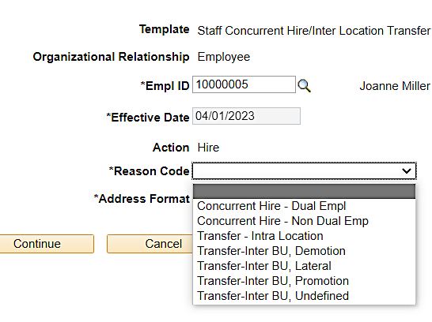
Inter-Location Process Steps
Hiring Department:
  Verify position to use for transfer, initiate the UC_Conc_Hire template and contact the employee’s current department. If unable to reach, contact the location’s Inter-Location Transfer Coordinator .
    Provide the hire transaction ID and relevant details.
    Verify position details are correct before initiating concurrent hire template.
    Effective date of the hire template should represent the employee’s start date.
    Reason Code Selection:
Use For: Local UCI Transfer + Create New Empl. Record
Use For: Transfers from Other UC Locations

Slide 11

Inter-Location Transfer Process Steps (II)
Contact Releasing Department or Transfer Coordinator:
  Hiring Department to contact & provide the Releasing Dept. all transfer details for transaction coordination.
  If the Releasing Dept. cannot be reached, contact the appropriate Location Transfer Coordinator, provide contact info for your Dept., along with transaction details.
Location Transfer Coordinator List:
https://www.ucop.edu/ucpath-center/_files/mypath/prod/business-analyst/itc-list.pdf

Slide 12
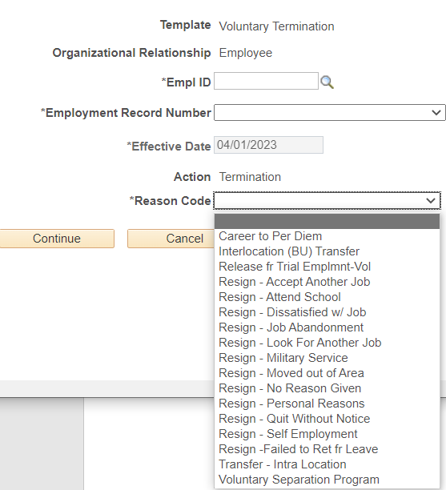
Inter-Location Transfer Process Steps (III)
Submit Voluntary Termination:
  The Releasing Department is notified of the intended transfer from the Hiring Department or Transfer Coordinator & submits UC_VOL_TERM template.
    It is strongly recommended to provide and/or reference the hire transaction ID # in the initiator comments section of the Termination template. This will help ensure final processing at UCPC is done correctly.
    If the termination template is submitted prior to the Concurrent Hire, the employee may get officially terminated, which may cause unwanted downstream impacts (i.e., lose their benefits, miss pay, etc.)
Effective Date of termination must be the same as the Start Date of new job.
Use For: Transfers from Other UC Locations
Use For: Local UCI Transfer + Create New Empl. Record

Slide 13

Inter-Location Process Steps (IV)
Establish Funding for New Transfer:
  Hiring Department will need to establish funding for the newly filled position prior to the Pay Confirm deadline, to ensure expenses are charged to the correct account.

Slide 14
Use Case Scenarios

Slide 15
Hiring Employee From Another UC Location
Hector Salazar is a HR Analyst from UC Berkeley and is transferring to UCI to work as an HR Analyst for the School of Engineering beginning on May 1st. Time is winding down and you are unable to reach the department to coordinate the transfer.
What template should be used?
UC_CONC_HIRE TEMPLATE
What is the Template Reason Code?
Interlocation (BU) Transfer
List the Transaction Steps:
Hiring Dept. to validate position & Initiate the Concurrent Hire template
  Reason Code: InterLocation (BU) Transfer
Hiring Department to Contact the employee’s current dept. or the Transfer Coordinator to plan transfer.
Releasing Dept. to Initiate the Voluntary Termination Template
  Reason Code: Interlocation (BU) Transfer
4. Hiring Department to ensure funding is identified on the new position

Slide 16
Hiring Employee from Another UCI School
(New Empl Record)
Elizabeth Joyner works as a Blank Assistant 2 for the School of Humanities and accepted a Finance Analyst job with the School of Business on June 1st. The schools would like to keep the job history separate, and not under the same employee record.
What template should be used for the Transfer?
UC_CONC_HIRE TEMPLATE
What should the effective date of the Termination transaction be?
June 1st / Same as Start Date of New Job
List the Transaction Steps:
Hiring Dept. to validate position & Initiate the Concurrent Hire template.
  Reason Code: Intra-Location Transfer
Hiring Department to Contact the employee’s current dept. or the Transfer Coordinator to plan transfer.
Releasing Dept. to Initiate the Voluntary Termination Template.
  Reason Code: Intra-Location Transfer
4. Hiring Department to ensure funding is identified on the new position.

Slide 17
Promoting an Employee
Yang Carter is being promoted to a Supervisor Position within her department and the HR Analyst needs to enter the transaction before the deadline.
What template should be used for the Transfer?
UC_Transfer
Is a Termination template required?
No Termination required
List the Transaction Steps:
Department to Initiate the UC_Transfer Template
  Reason Code: Promotion
Ensure funding is identified on the new position.

Slide 18
Q&A

